Slide 1
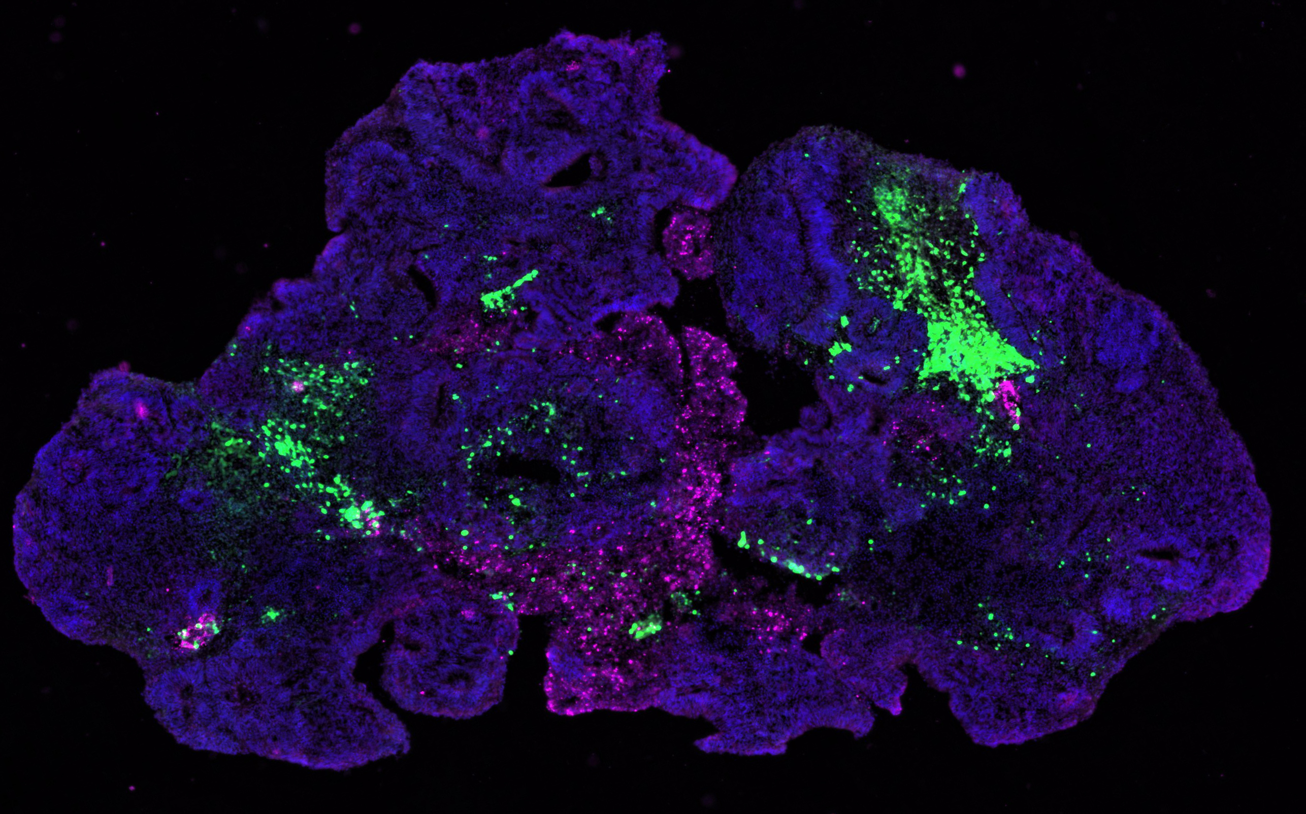
From Brain Development to Brain in the Dish: 3D Human Brain Organoids
SCRB 182
Fall 2016

Slide 2
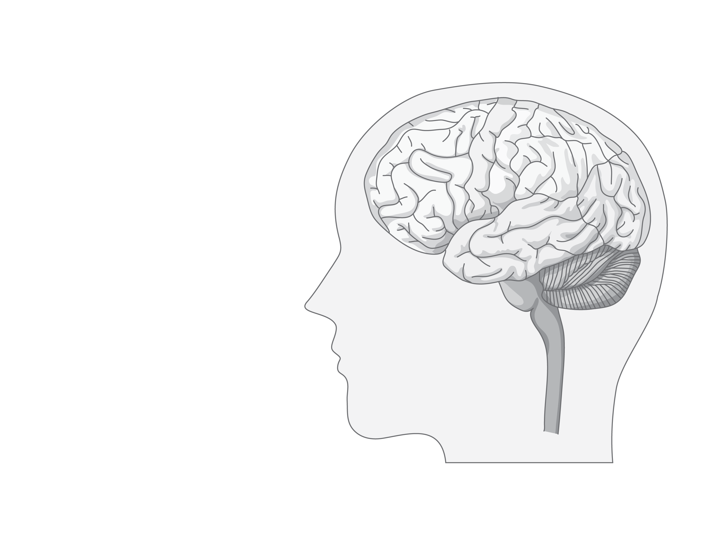
Neuropsychiatric Diseases
Schizophrenia
Bipolar Disorder
ADHD
Autism Spectrum Disorders

Slide 3
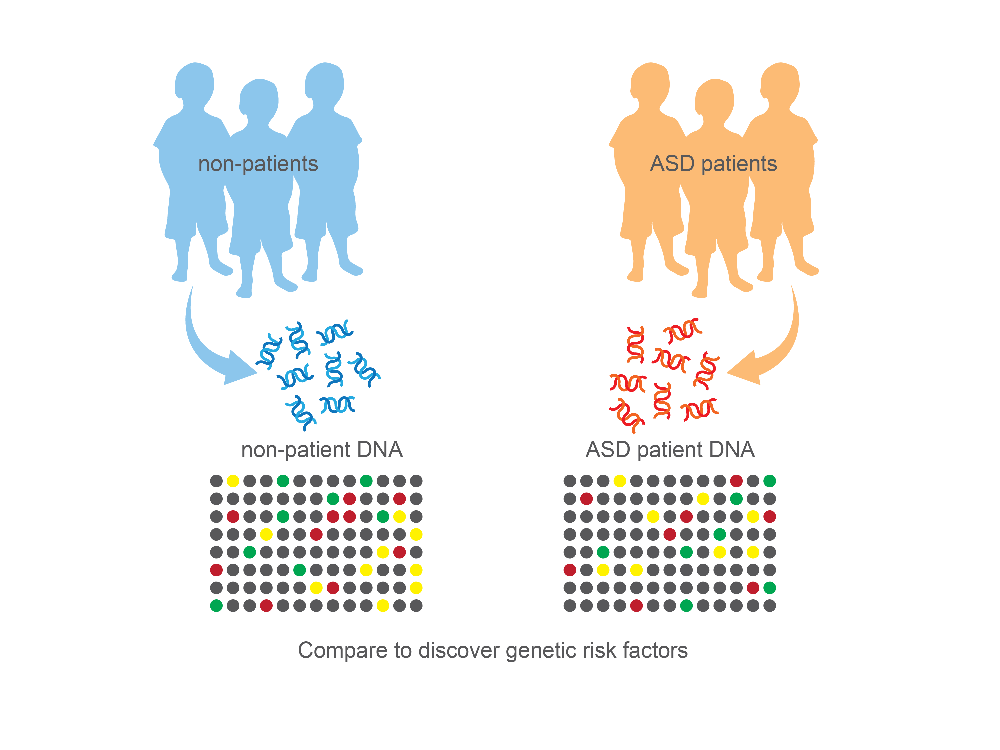
The Genetics of Autism
>100 disease-associated variants
Neale et. al; Nature 2012 and
Silvia De Rubies et. al; Nature 2014
Notes:
We now have so much information on the genetics of these complex neuropsychiatric diseases, yet, the problem remains of how we are going to understand what each set of mutations do to the brain and what cell types are involved. We need to be able to look at gene expression in human cells, purified from the human brain. Yet the human brain contains an extreme diversiy of cell types. How are we going to select /purify out invividual classes to understand whch ones are affected?

Slide 4
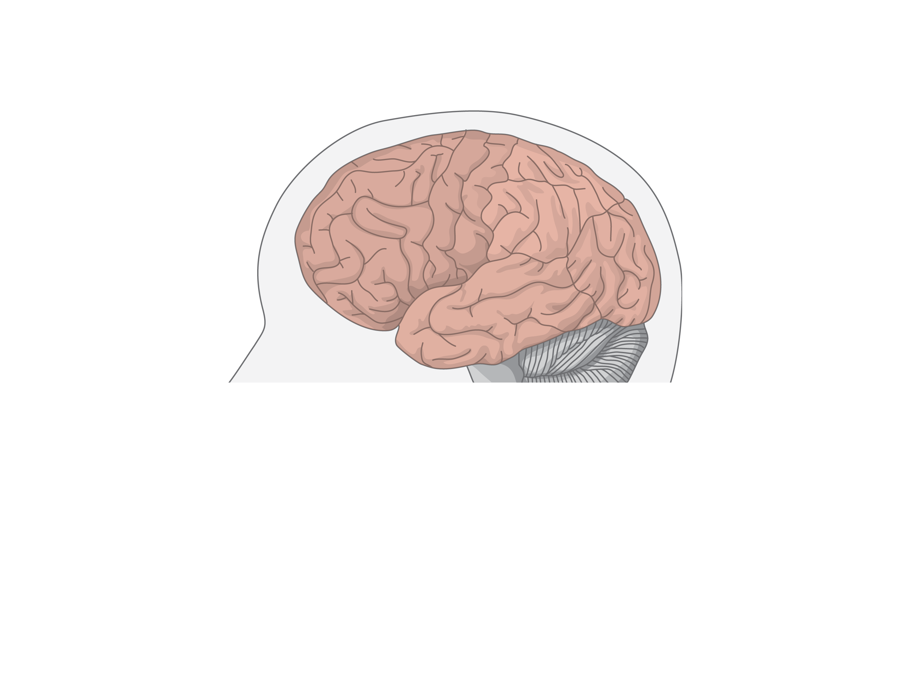
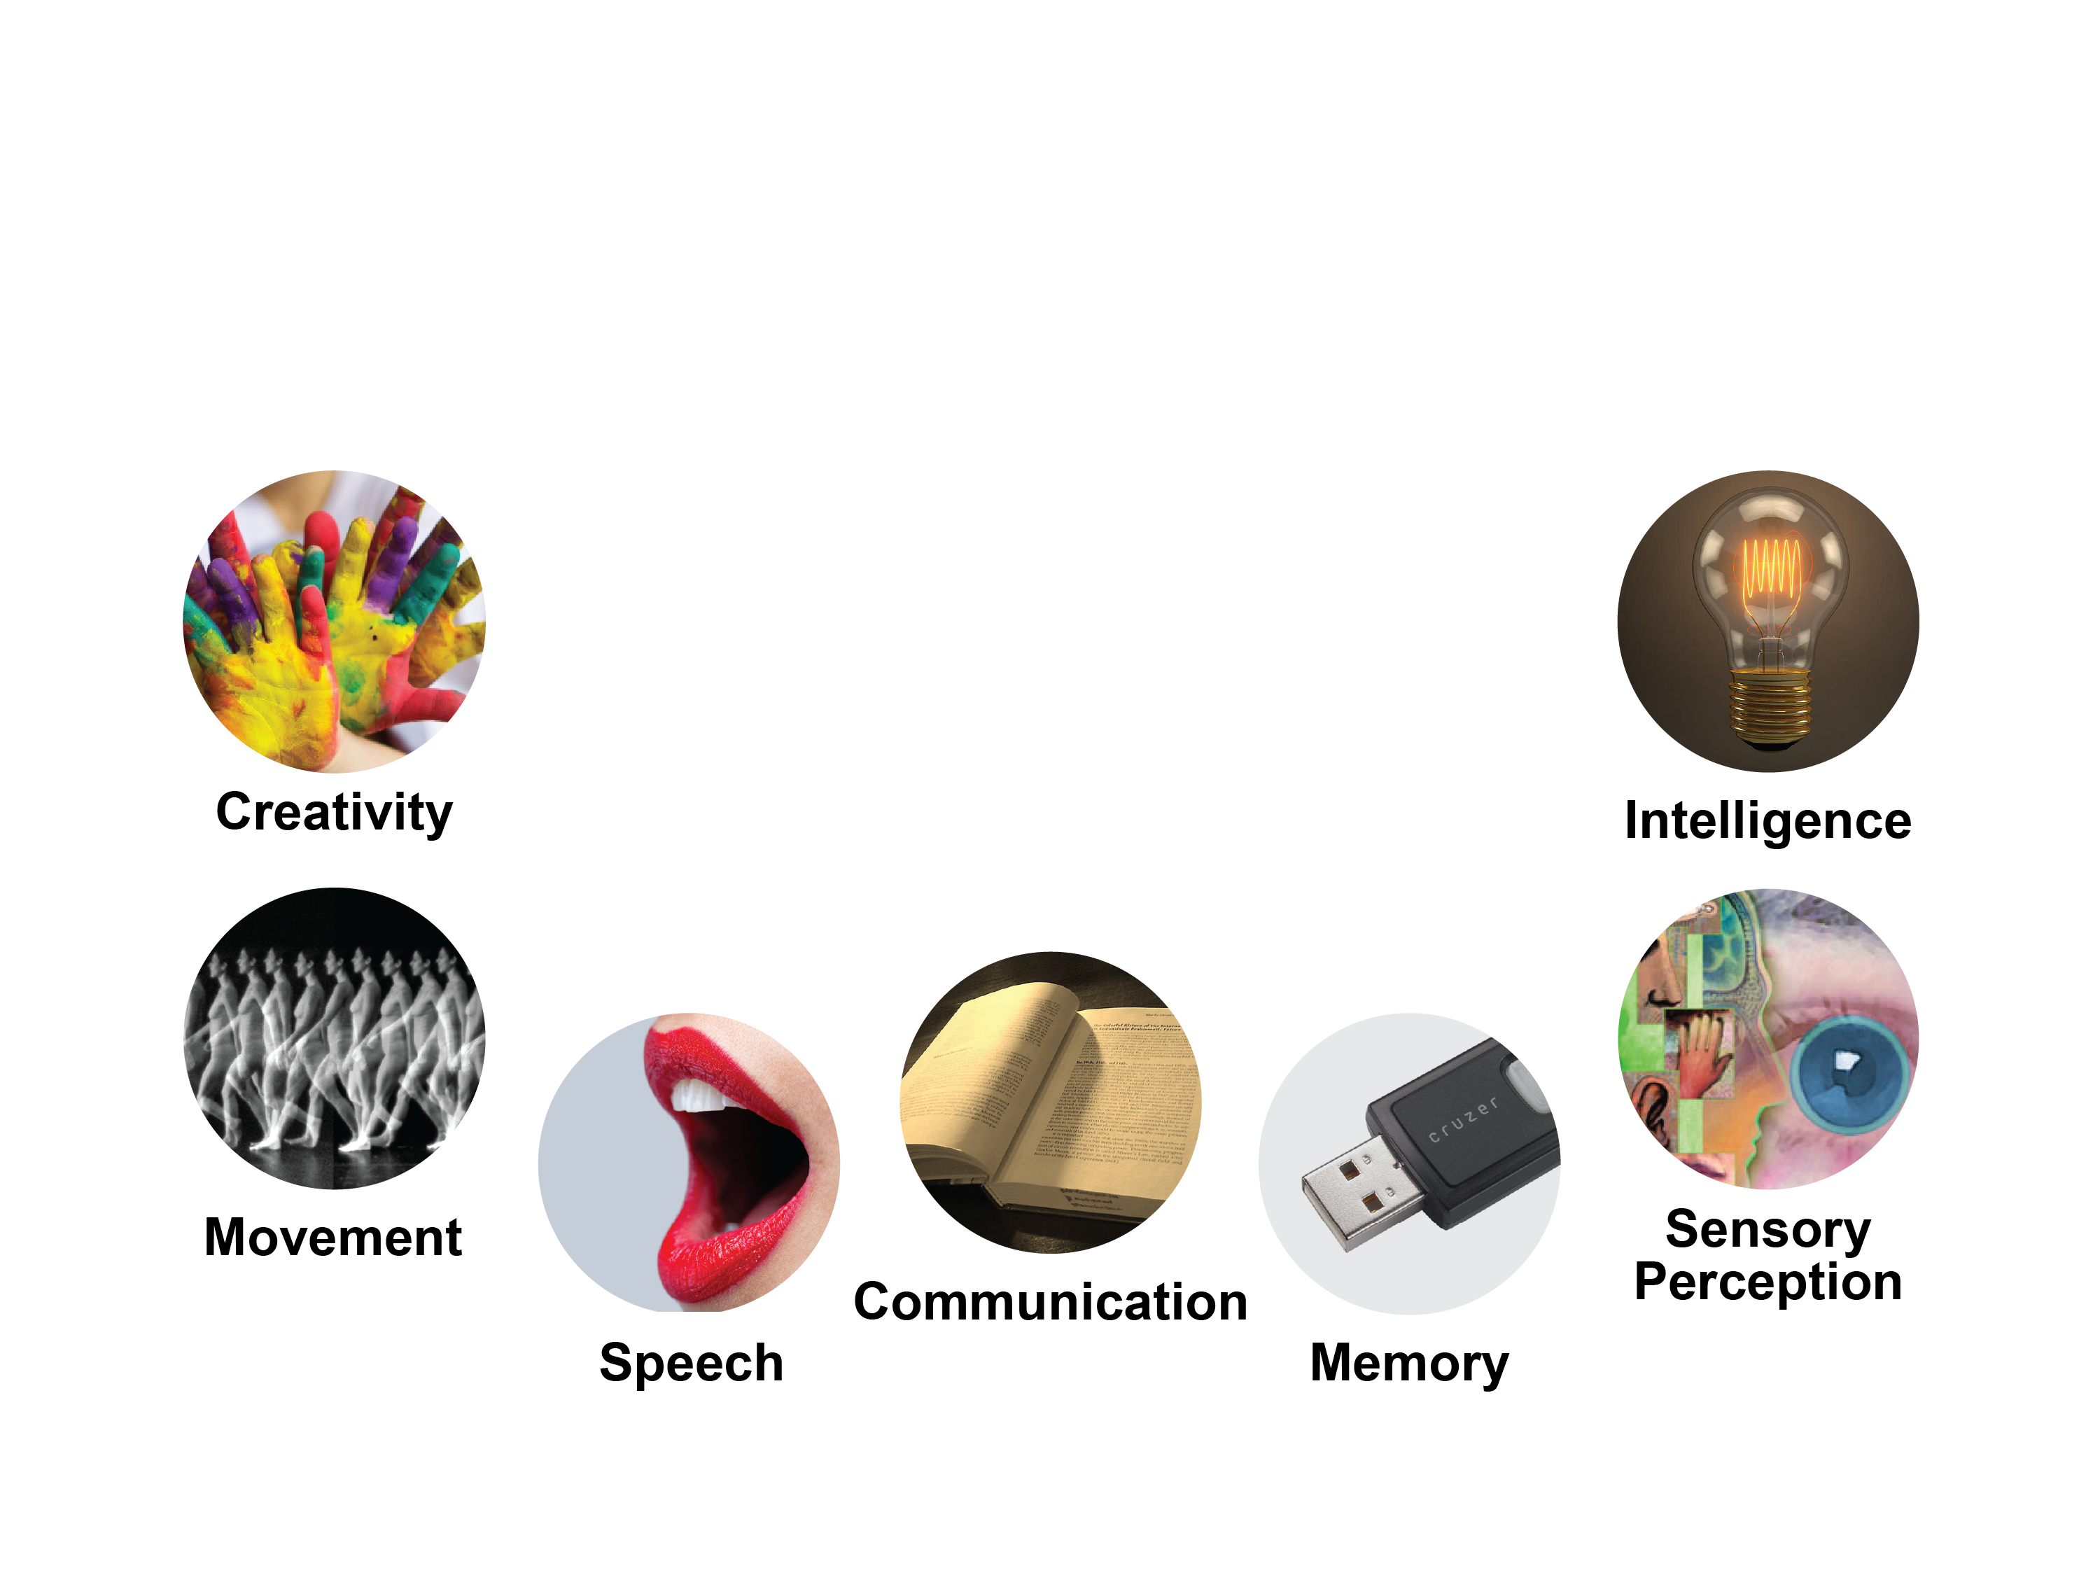
The Cerebral Cortex

Slide 5
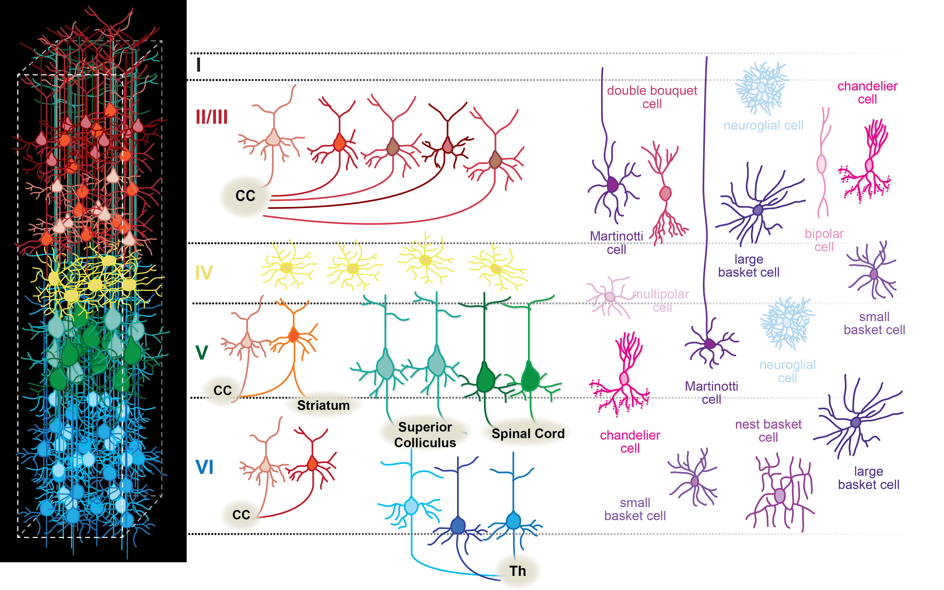
Neuronal Diversity in the Cerebral Cortex
Projection Neurons
Interneurons
Lodato and Arlotta. Annual Rev Cell Dev Biol (2015)
Notes:
Several questions remain unanswered regarding how this diversity of neuron types is 1. built during development, whether 2. this landscape is irreversibly defined by the end of developmental neurogenesis or, rather, amenable to change in the adult, and more broadly what is the 3. role played by distinct neuronal classes for cortical assembly and function --

Slide 6
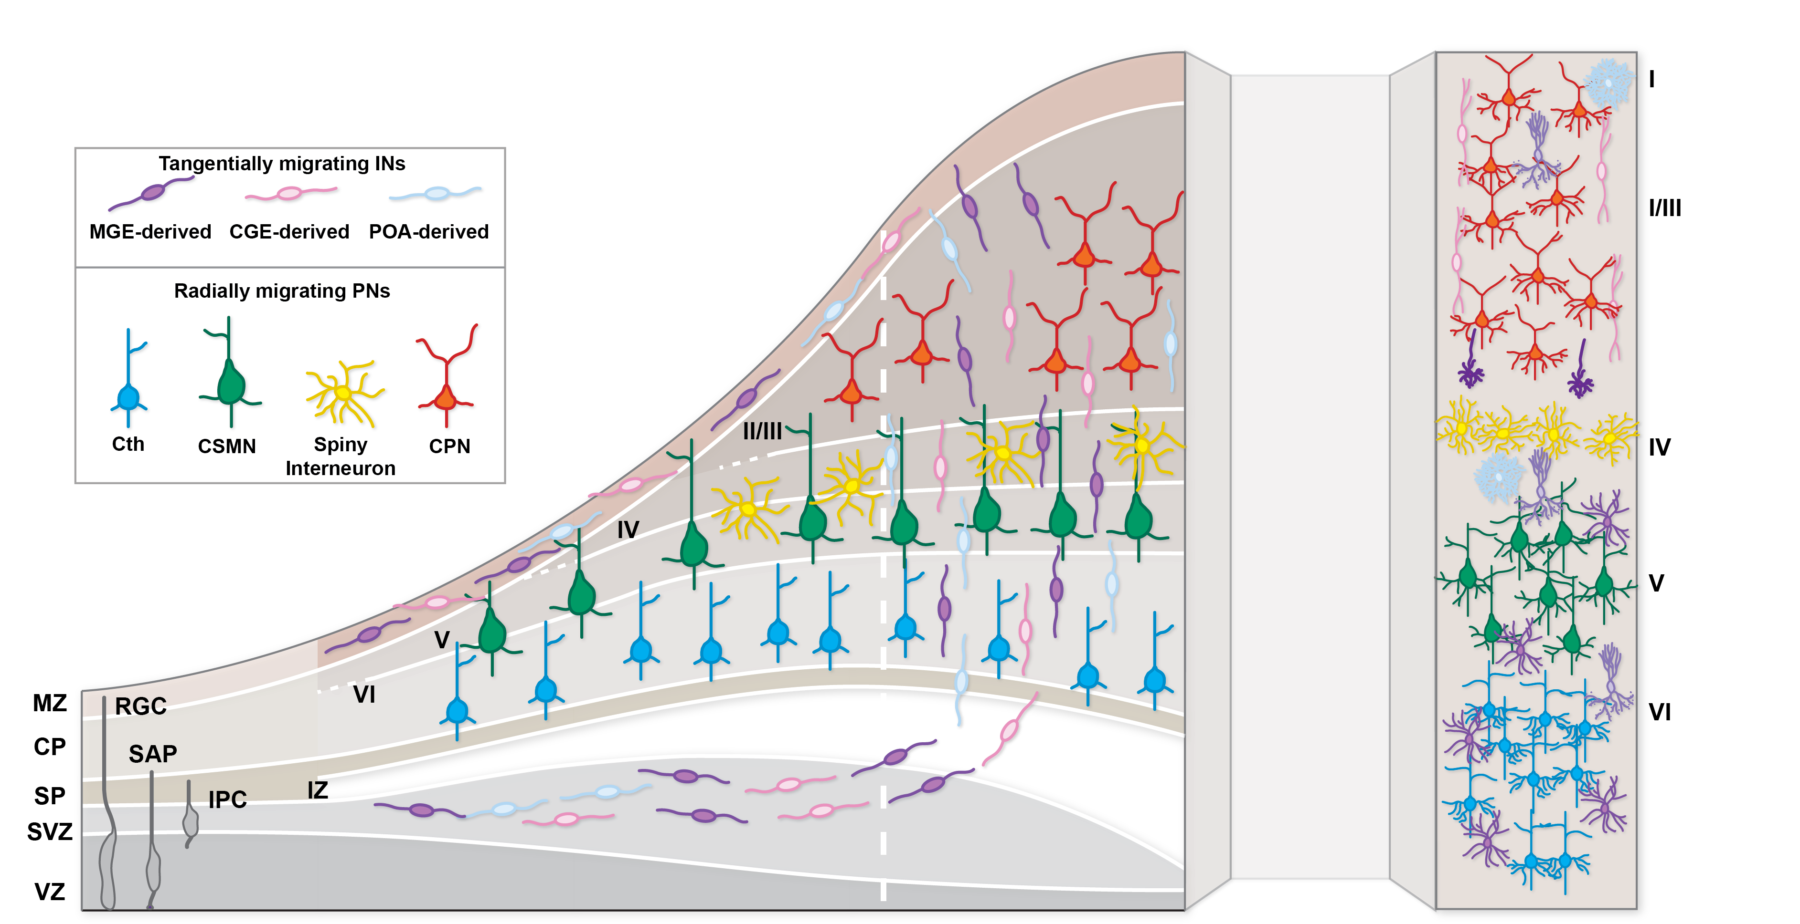
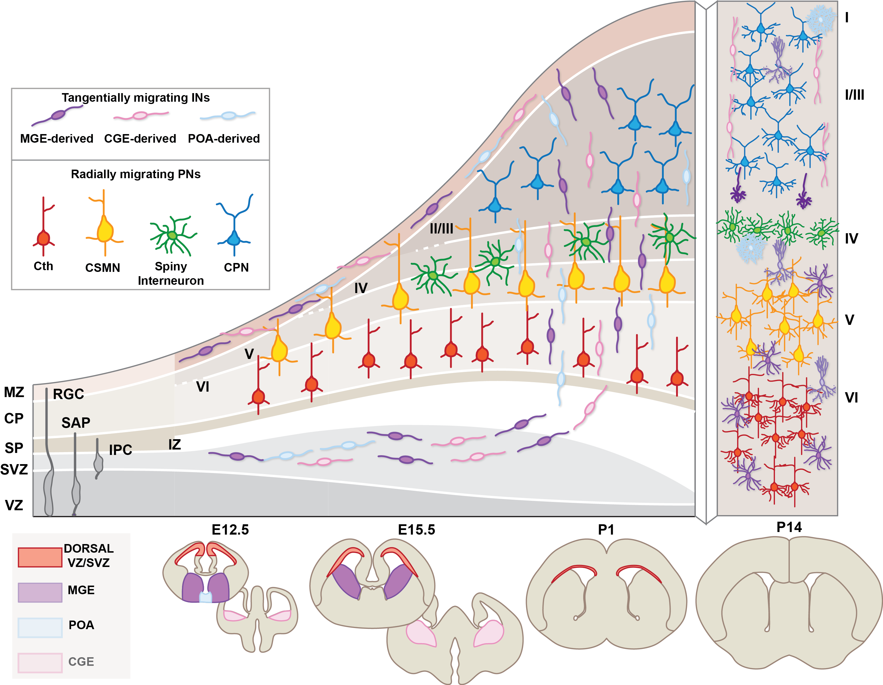
Notes:
Dennis:
Add some texture/ 3D effect to the wave of neurogenesis

Slide 7
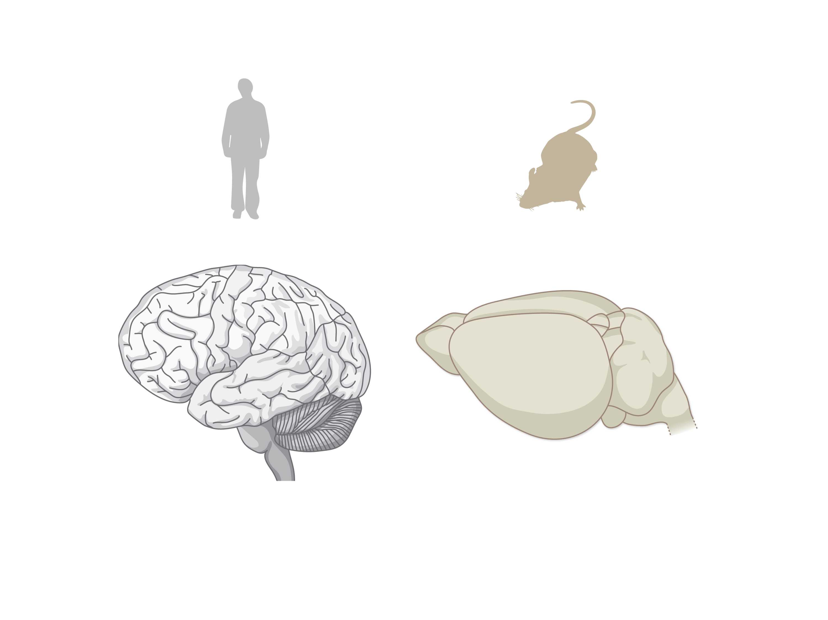
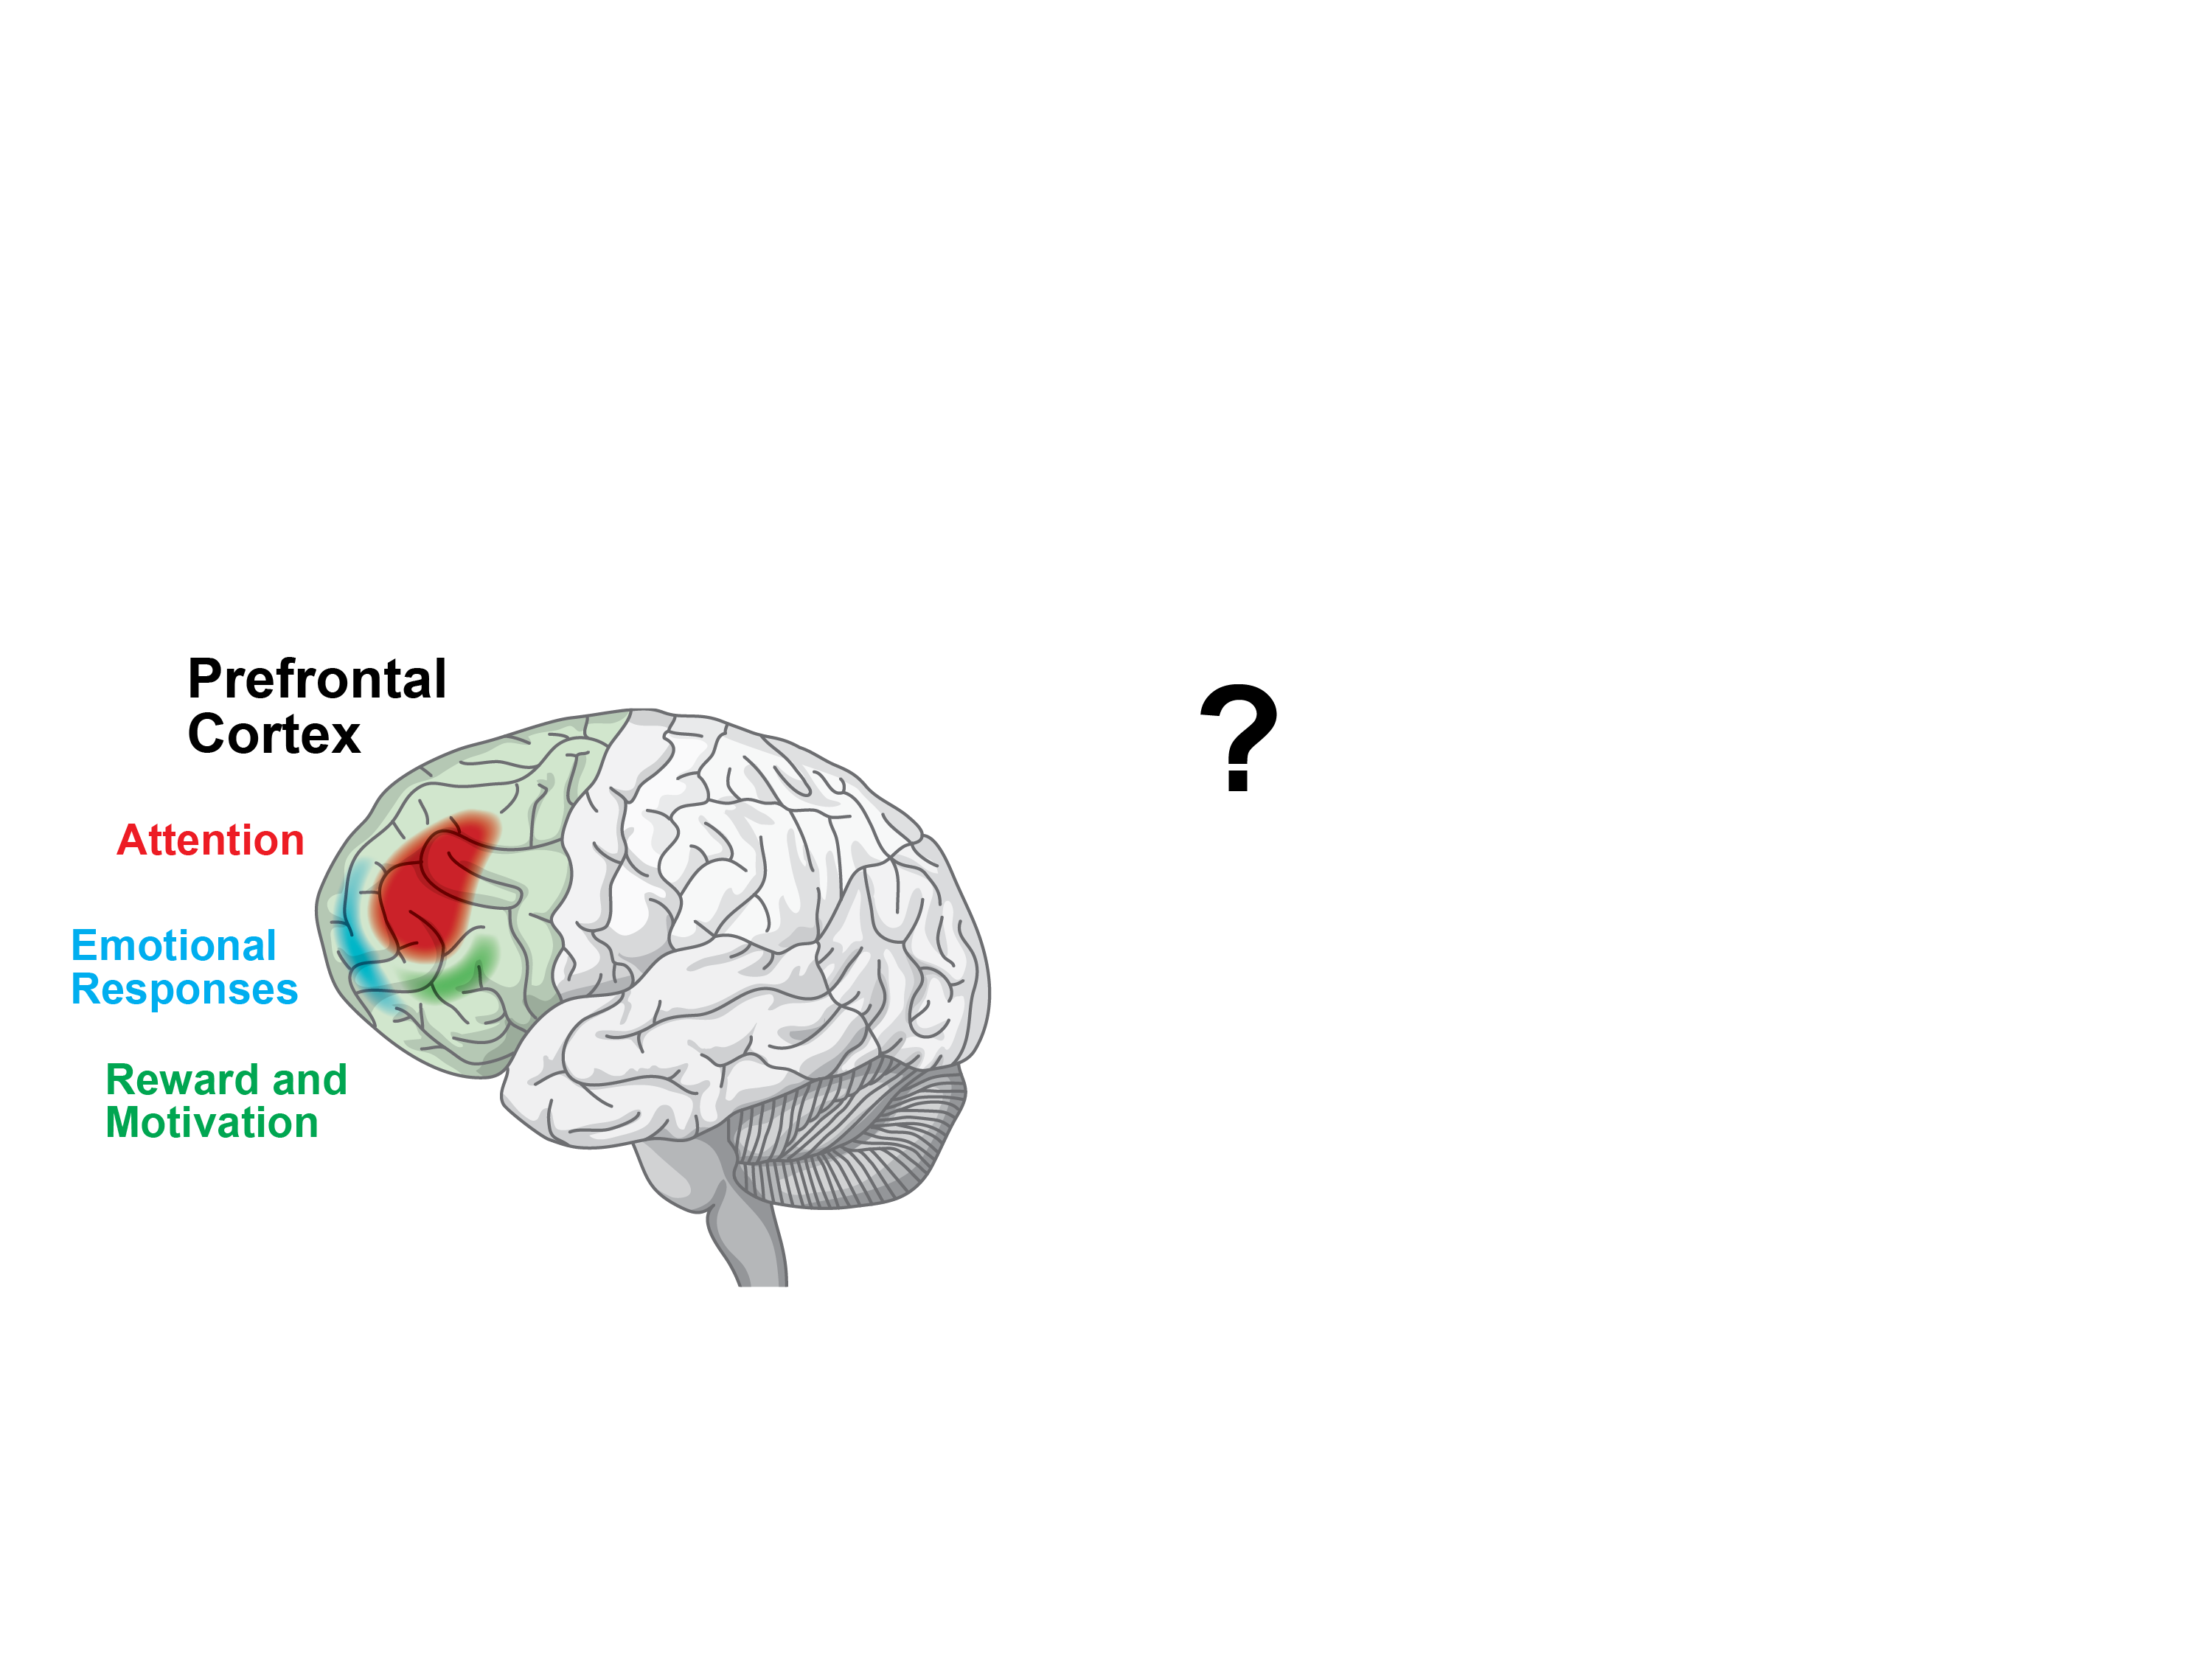
Of Mice and Men
Notes:
.

Slide 8
Self-directed Organogenesis

Slide 9
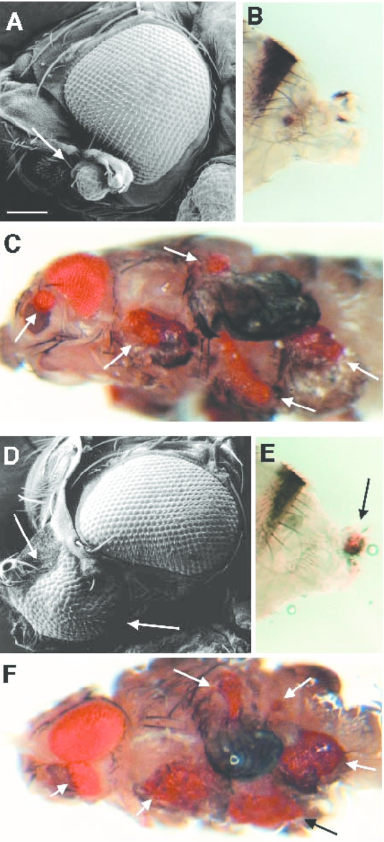
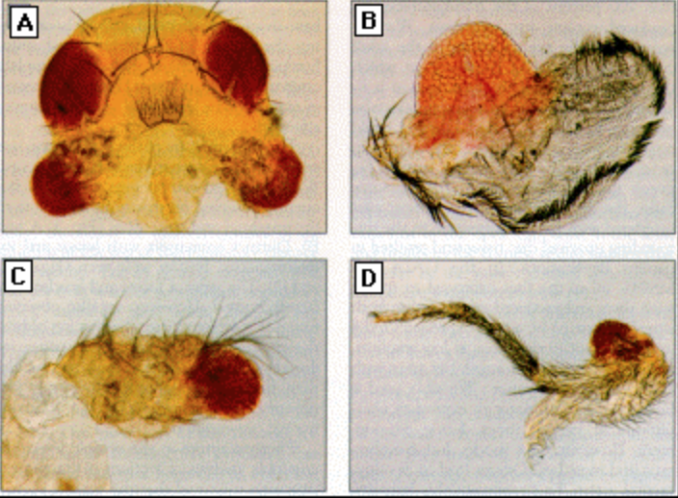
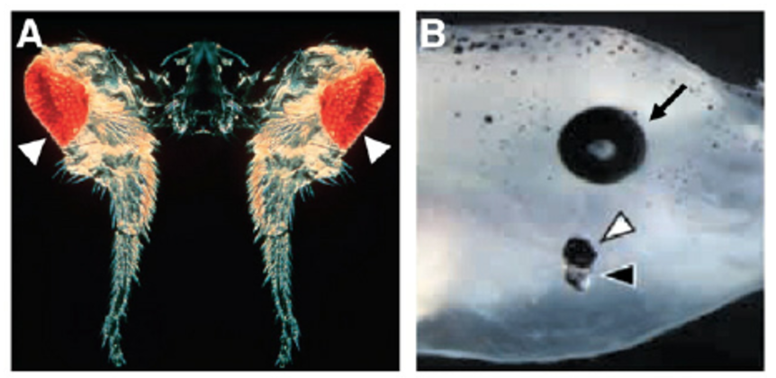
Making Ectopic Eyes

Slide 10

Making an eye: self-assembly required

Slide 11
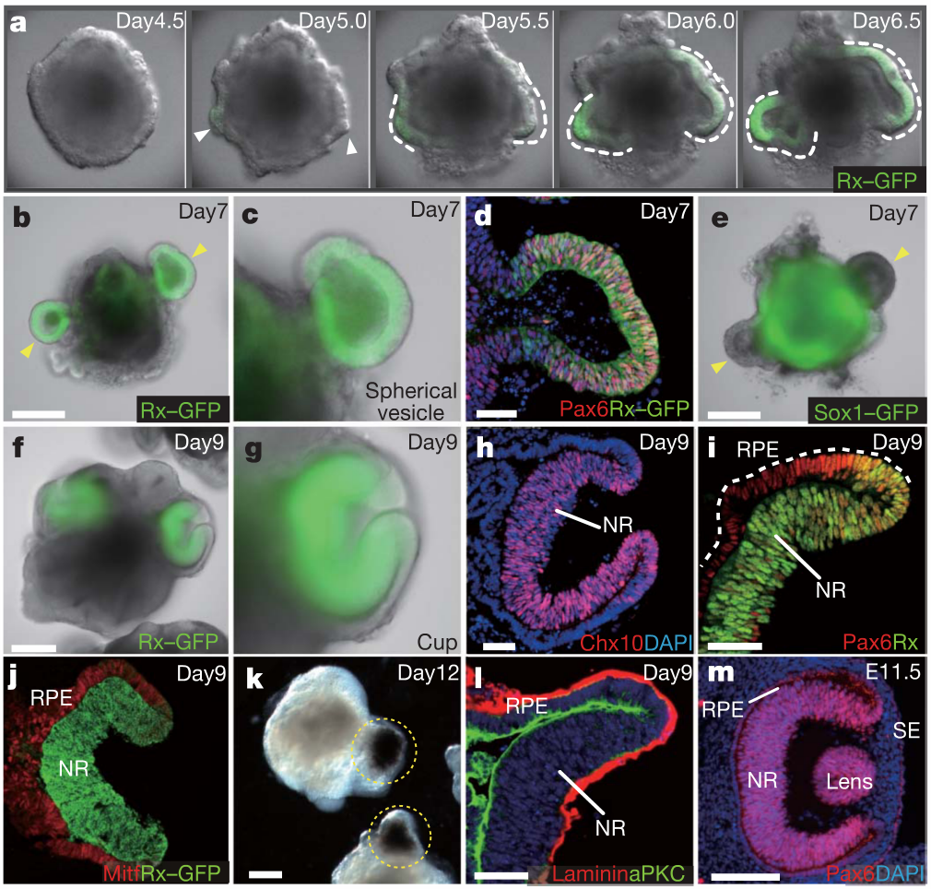
Making an eye: self-assembly required
Eiraku et al., Nature 2011

Slide 12
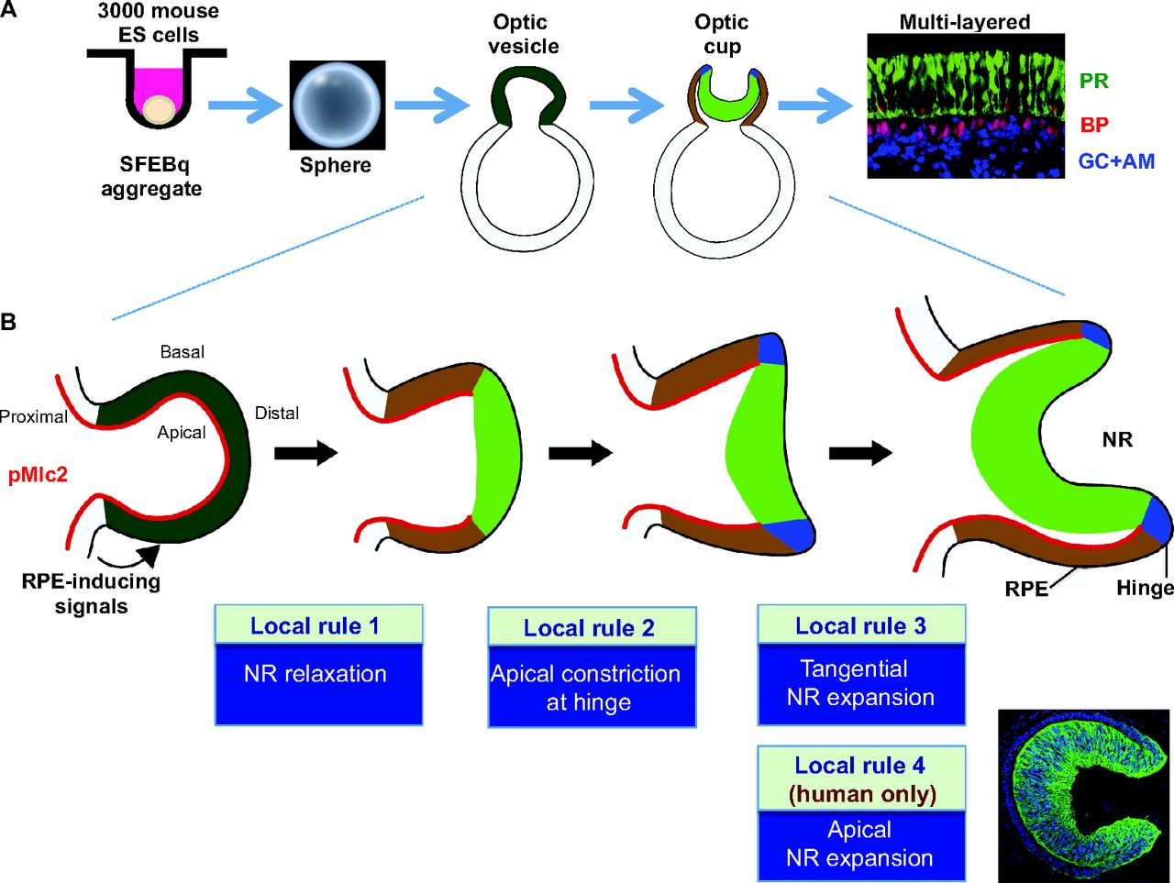
Making an eye: self-assembly required
Yoshiki Sasai et al. Development 2012;139:4111-4121

Slide 13
How about brain? How about cortex?
Notes:
Dennis:
Add some texture/ 3D effect to the wave of neurogenesis

Slide 14
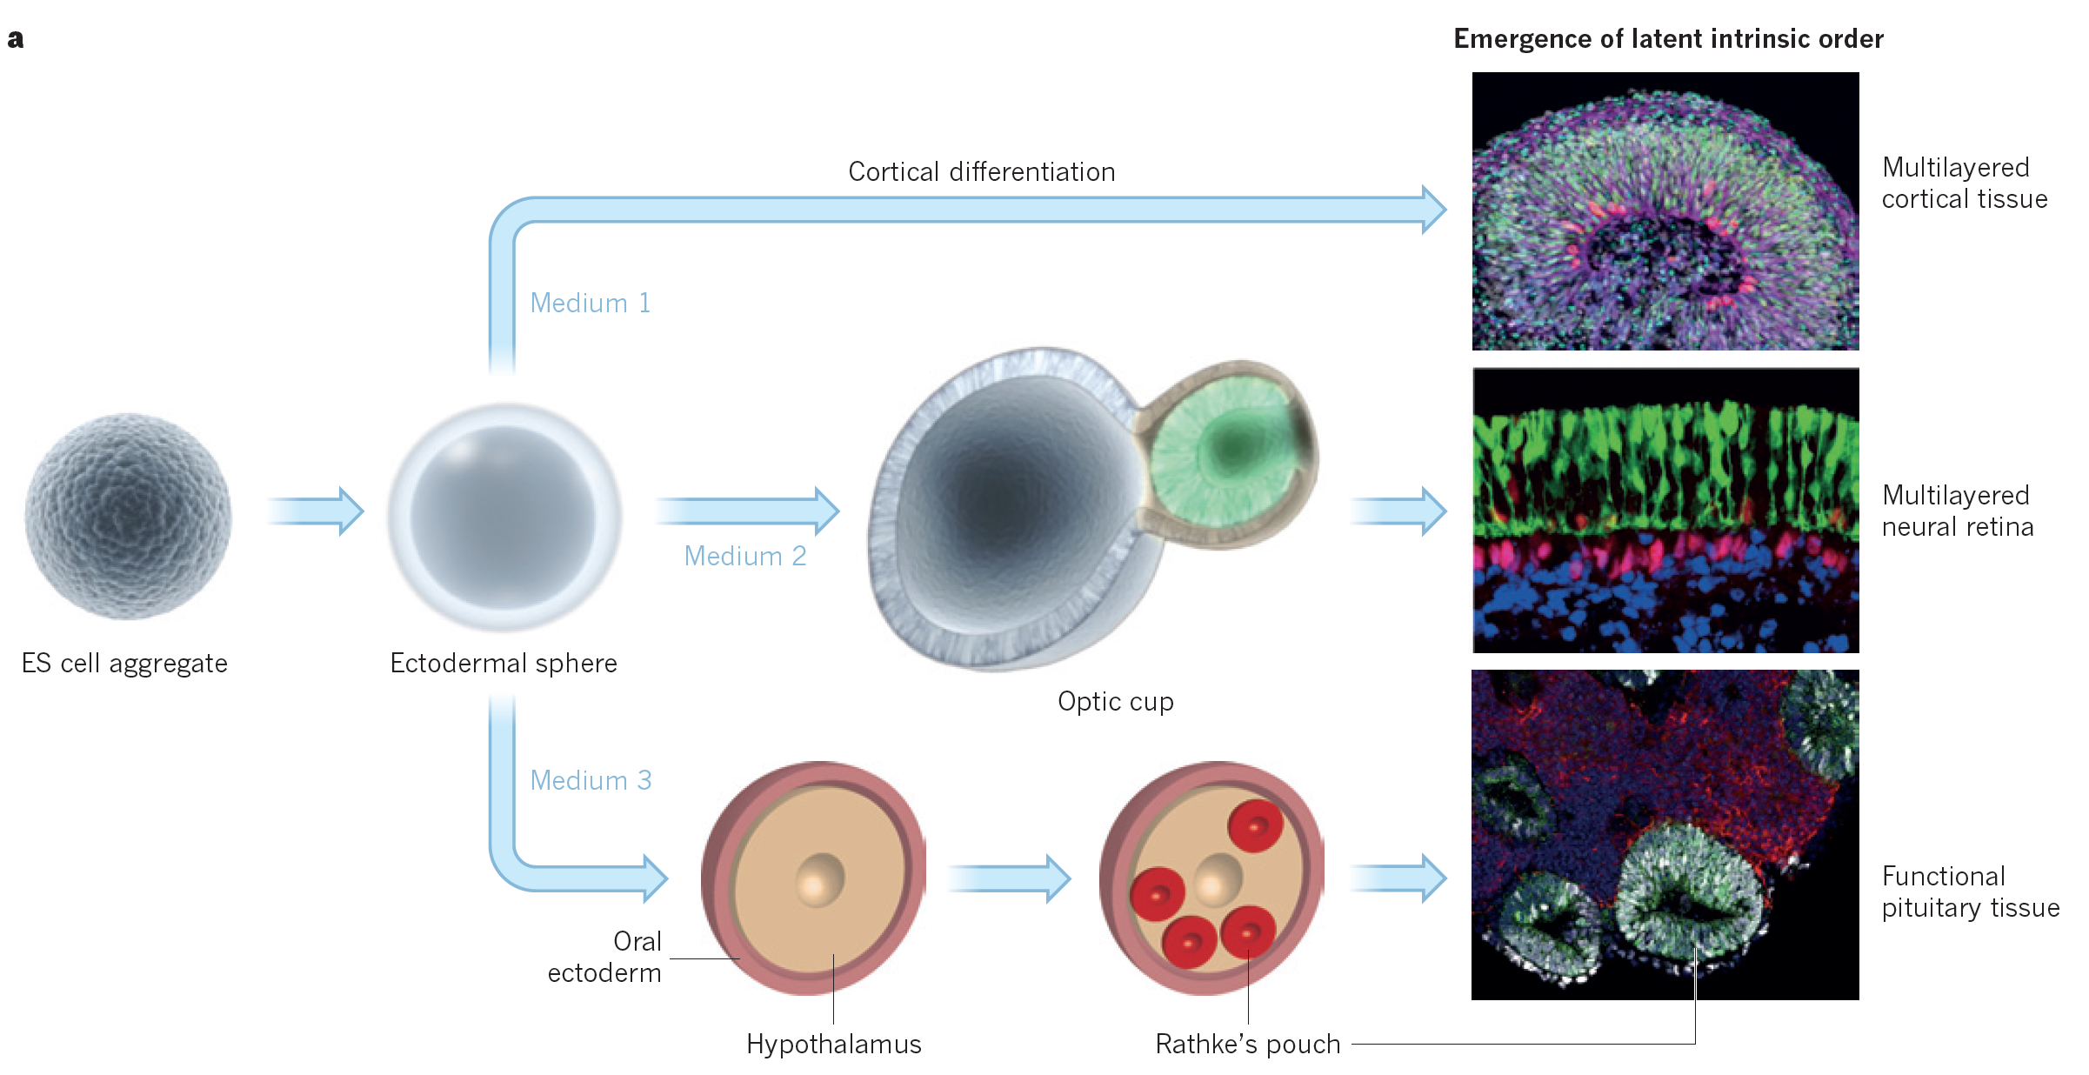
Self-assembly of the “brain”

Slide 15
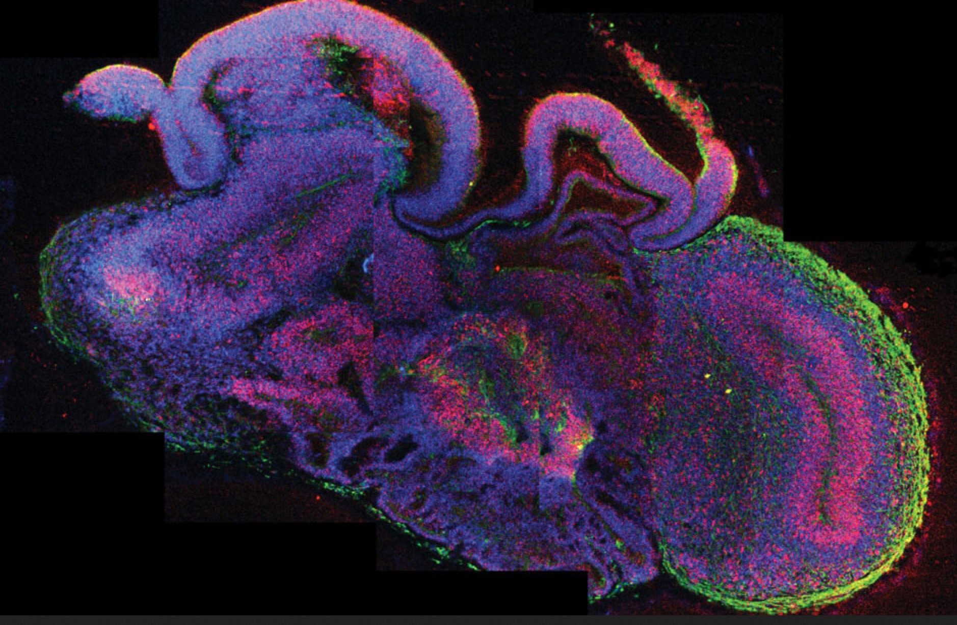
Human Brain Organoids
Lancaster et al., Nature 2013

Slide 16
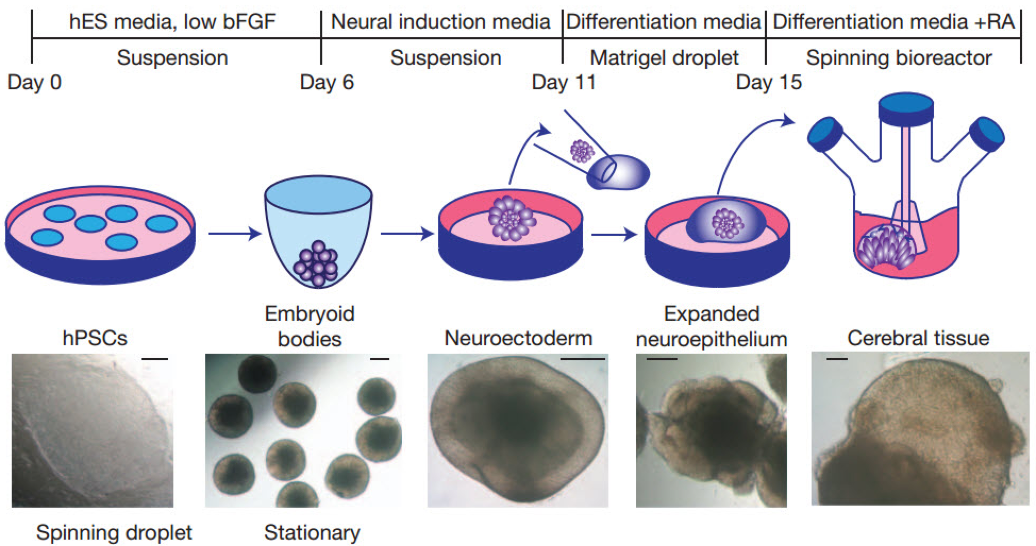
3D Human Brain Organoids

Slide 17
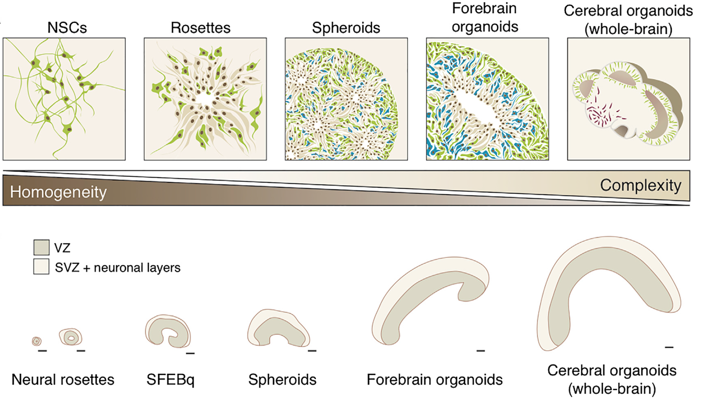
Knoblich, Lancaster, Song, Ming, Pasca, Kriegstein, Vaccarino laboratories ….
Kelava and Lancaster, Cell Stem Cell, 2016

Slide 18
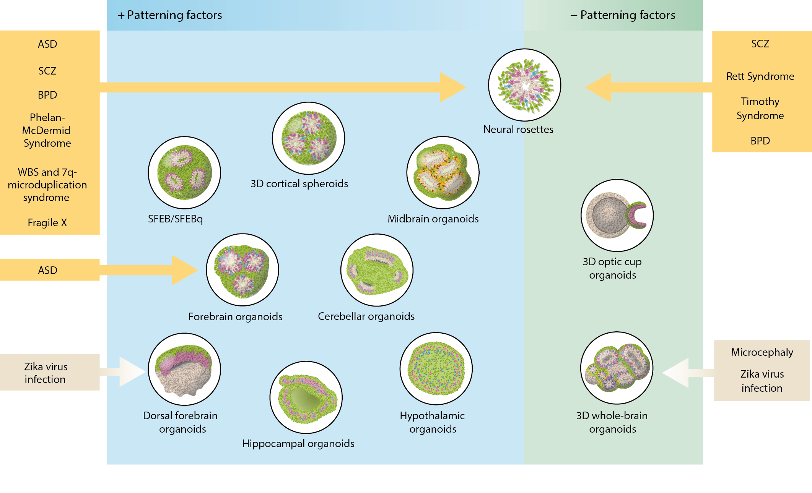
hPSC-derived brain organoids and spheroids
Quadrato, Brown, Arlotta, Nature Medicine (2016)

Slide 19
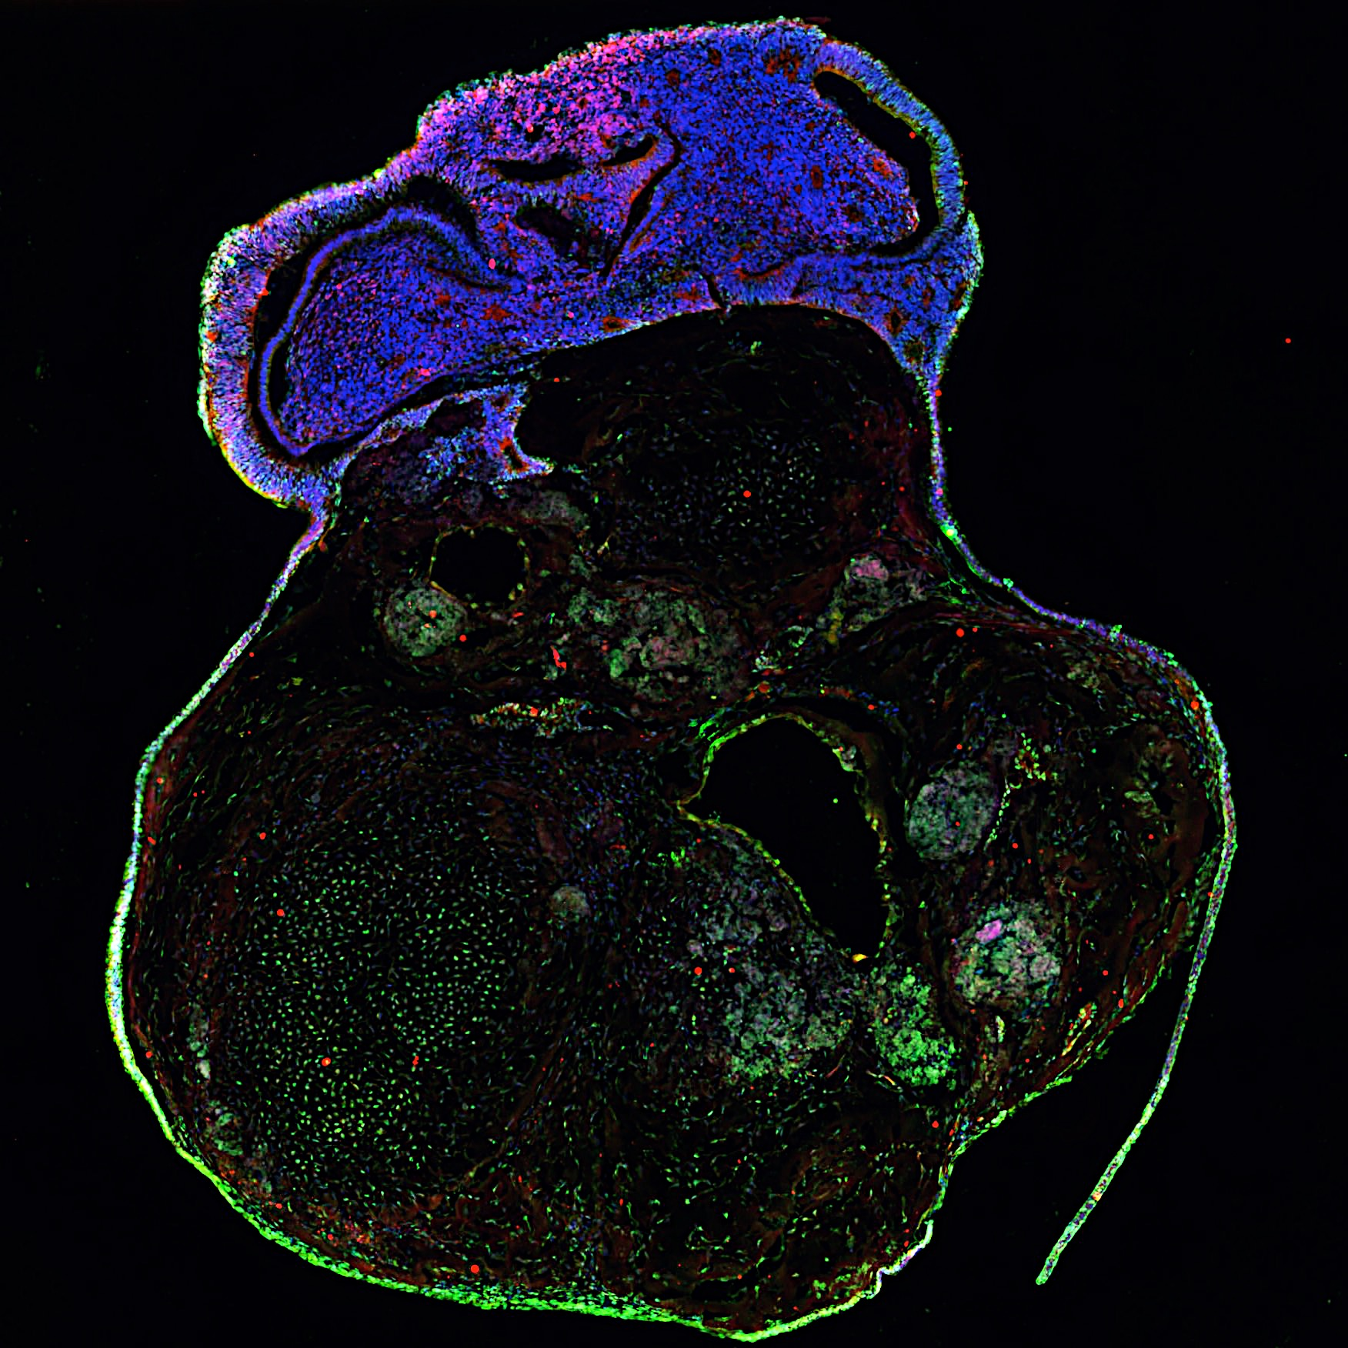
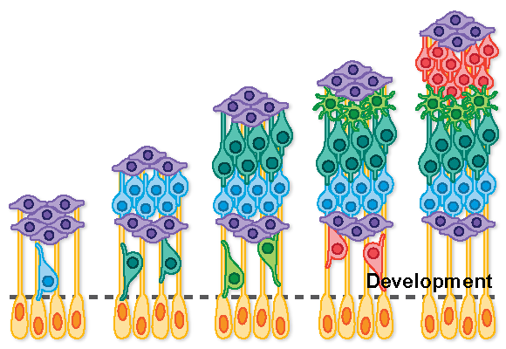
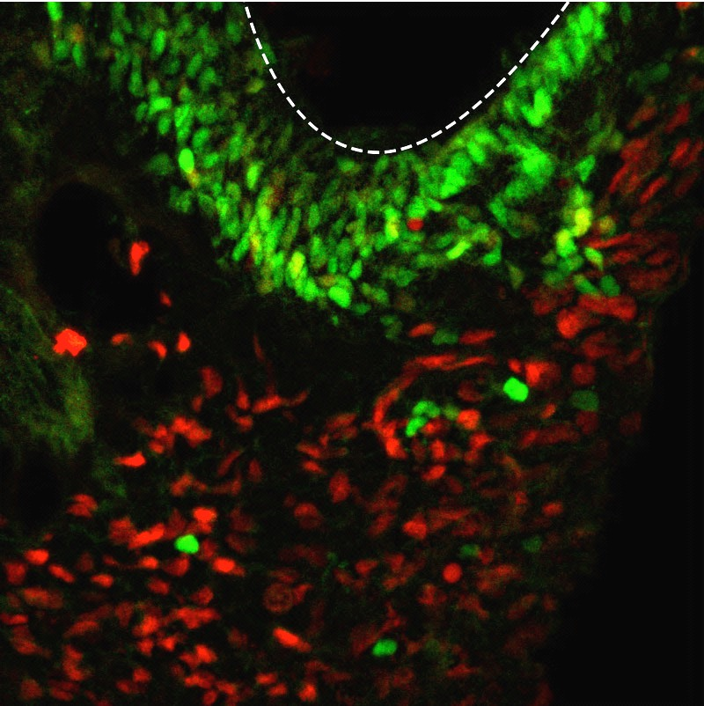
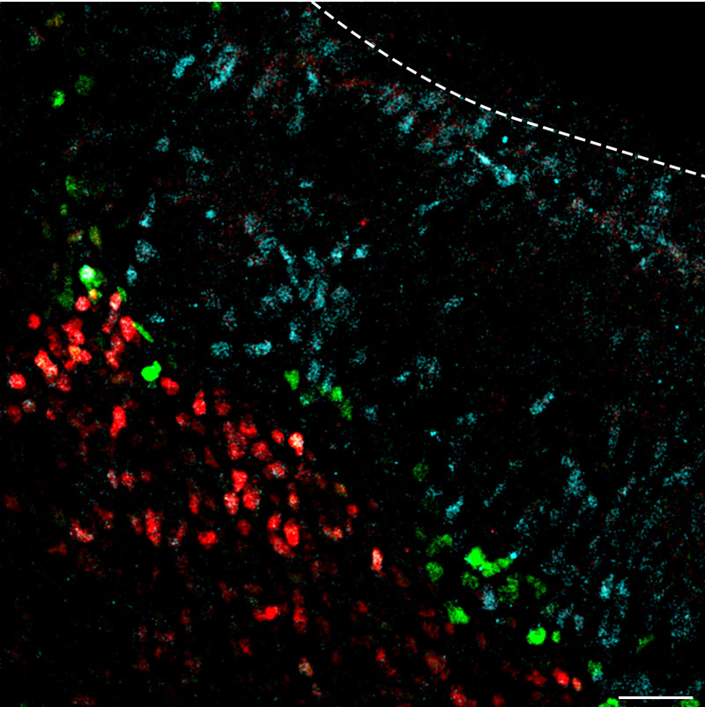
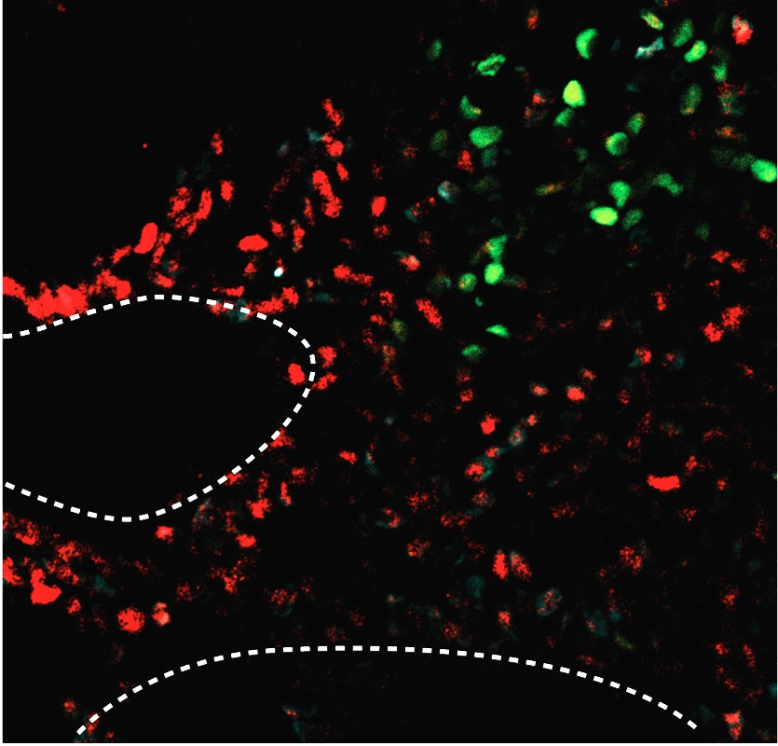
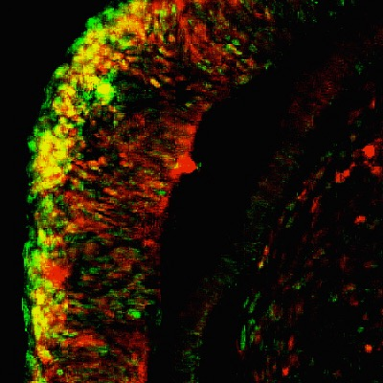
Brain organoids display radially layered structures
PAX6 CTIP2 DAPI
CUX1 BRN2 DAPI
1 mo
6 mo
CUX1
BRN2
SATB2
CP-like
CTIP2
TLE4
PAX6
PAX6 CTIP2
SATB2 CTIP2 TLE4
CUX1 CTIP2
CUX1 BRN2
1 mo
2 mo
3 mo
6 mo
CP-like
L5-like
L2/3-like
L2/3-like
V
L5/6-like
L6-like
V
VZ-like
V
V

Slide 20
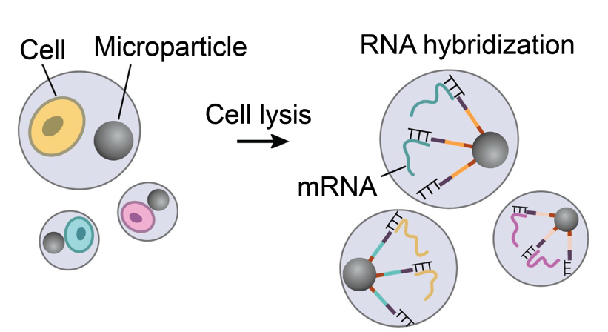
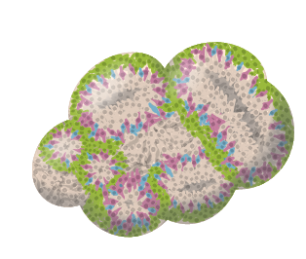
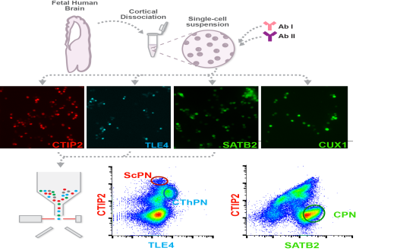
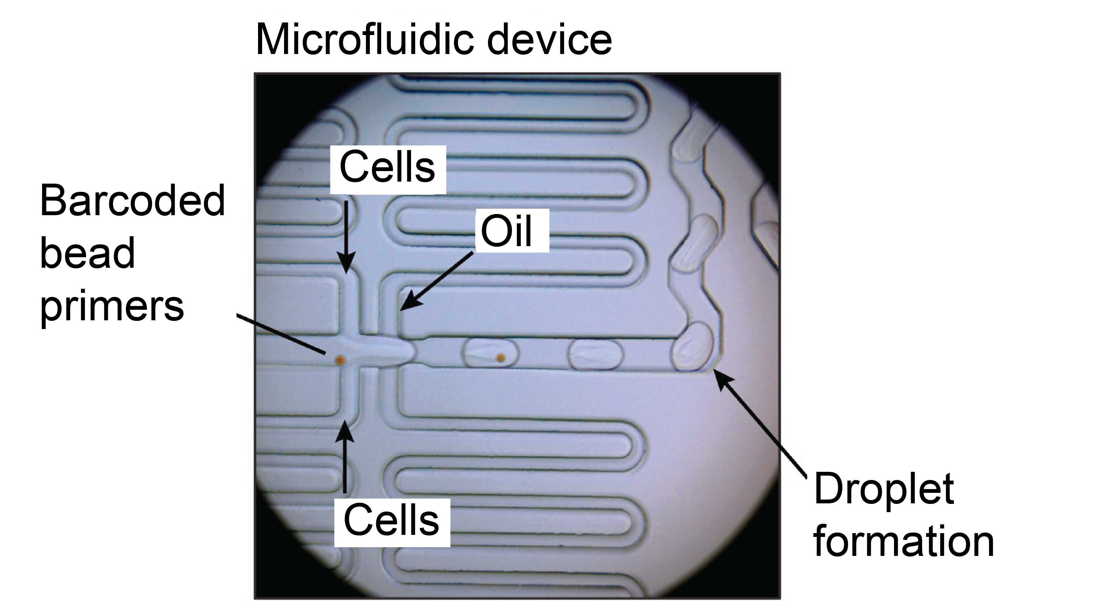
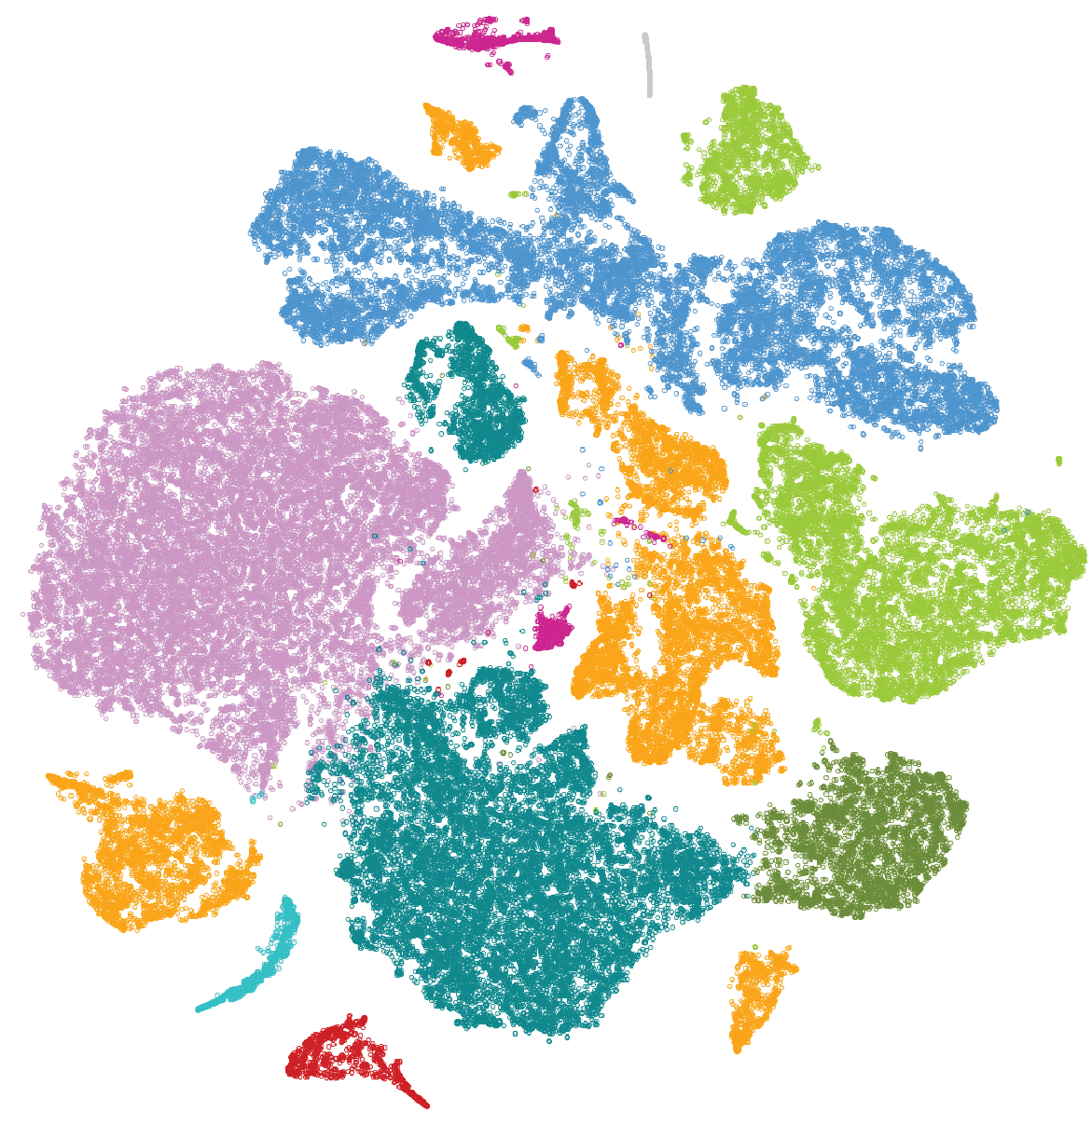
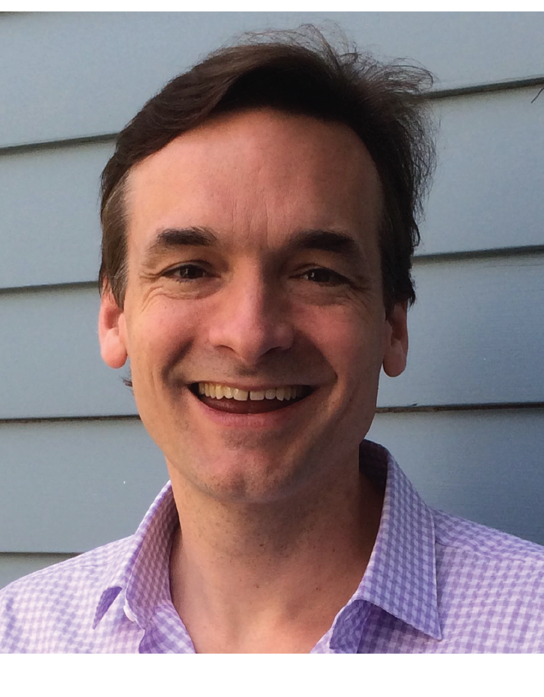
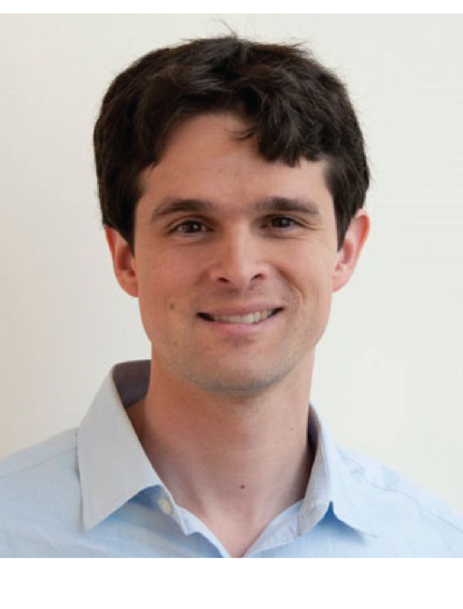
What cells can be made in human brain organoids?
--Drop-seq single cell analysis--
Organoids 6mo (n = 19)
Single cell suspension
66,889 cells
10 big clusters
Steve McCarroll
Evan Macosko

Slide 21
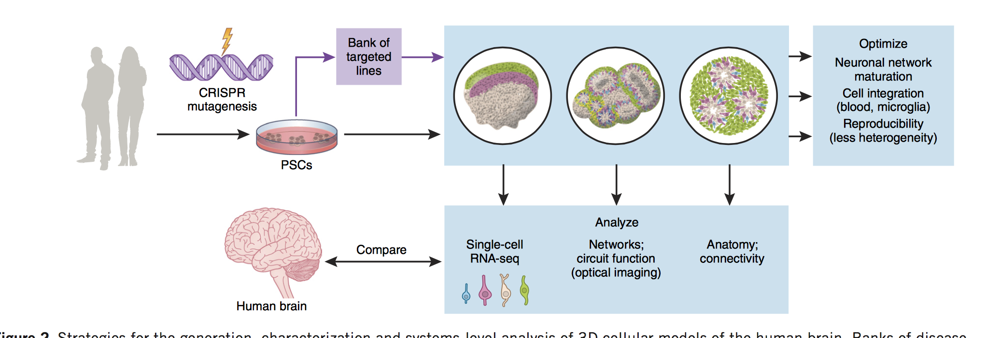
What Next?

Slide 22
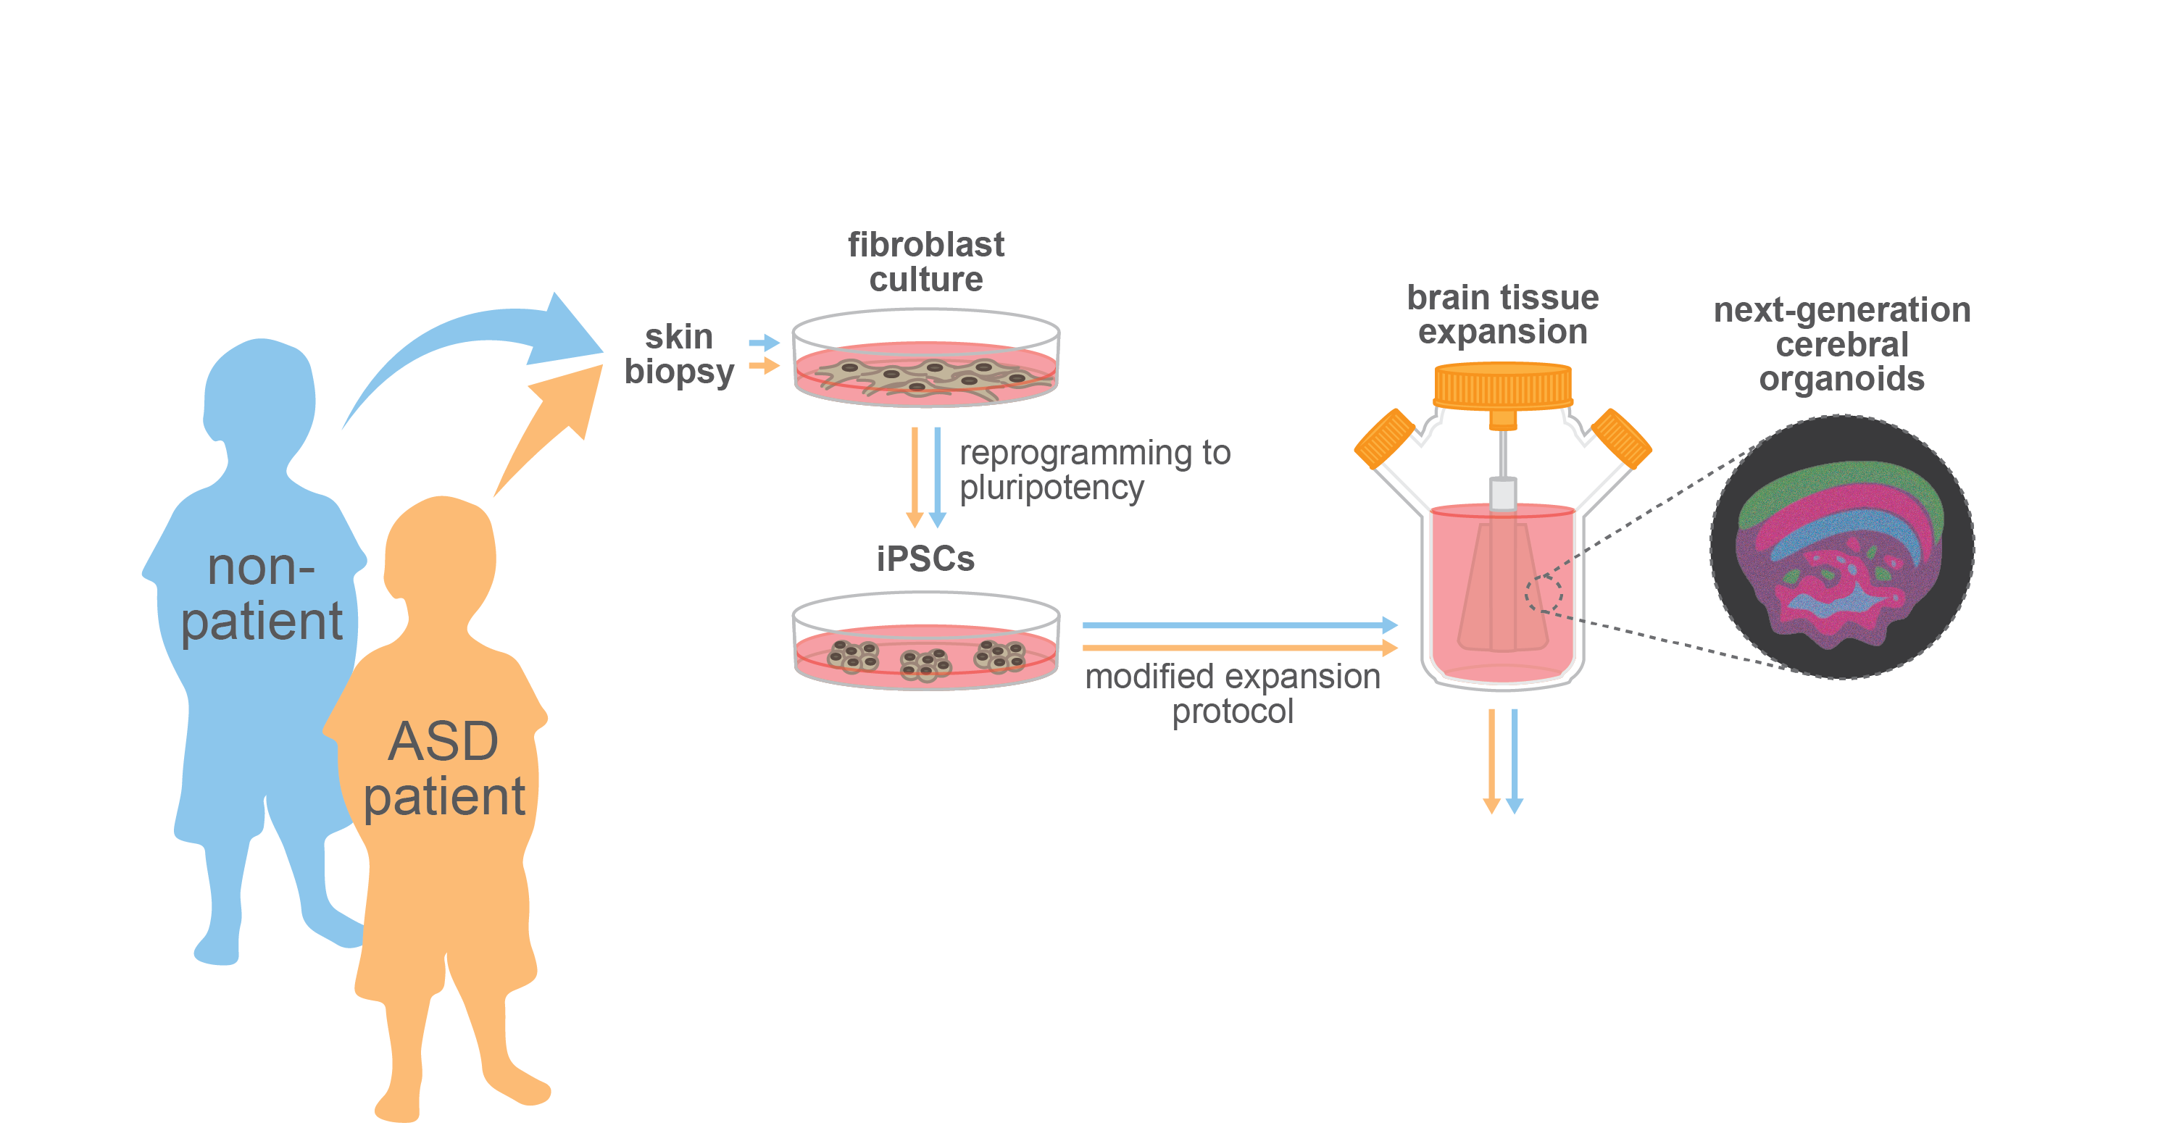
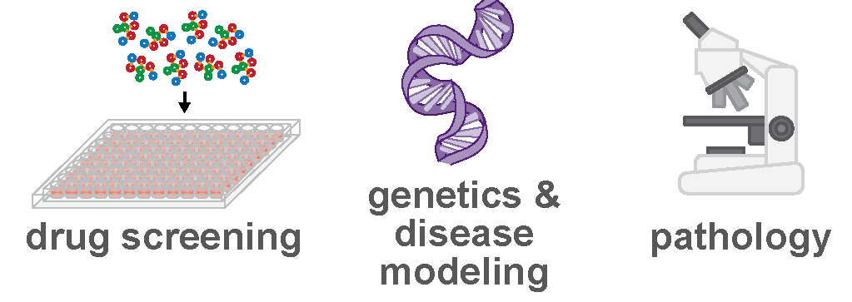
Human models of neuropsychiatric disease

