Slide 1
Pulmonary Embolism
MINICASES
.
3/23/18

Slide 3
Ayse Katenay is a healthy 29 year old woman. Ms. Katenay is traveling from California to Boston on a seven hour plane flight where she is presenting at a conference on Native American Health. Two weeks prior to the trip, she suffered a rock-climbing accident and tibial fracture involving the articular surface of her distal femur. She is in a long-leg cast. For the last few days prior to the trip, her leg has been more swollen and uncomfortable. She considered staying home, but this was an important presentation for both her career (she is head counsel for the Navajo Nation) and the tribe. The night before her trip, she was so busy putting last minute touches on her talk that she skipped dinner. She also got up late, and had no time for breakfast.
You happen to be sitting next to Ayse on the plane. You check her pulse—it is strong, HR = 110, RR = 20. You notice that her foot is quite swollen below the cast. You remember your fabulous Homeostasis I course, and think about what you would do if she was your patient in the Emergency Department.

Slide 4
Question 1. Describe a screening blood test could be used to help guide further evaluation in a patient with possible deep venous thrombosis and/or pulmonary embolism.? Would this be appropriate for Ms. Katenay?

Slide 5
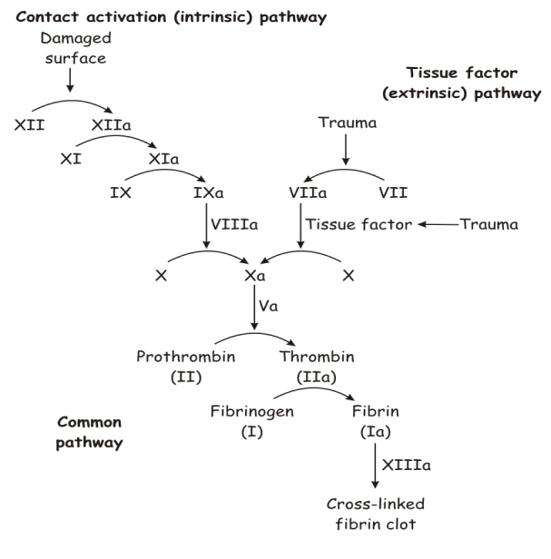
PLASMIN
Fibrin degradation Products
(d-dimers and others)

Slide 6
PE Diagnosis:
D-dimer Assay
D-dimer blood test
Degradation product of cross-linked fibrin
Excellent screening tool
  High sensitivity and High Negative predictive value
  Not a specific test
Plasmin
Fibrin Degration Products
(d-dimers and others)
Fibrin

Slide 7
Question 2. IF you were seeing her in the ED, what would you do next?

Slide 8
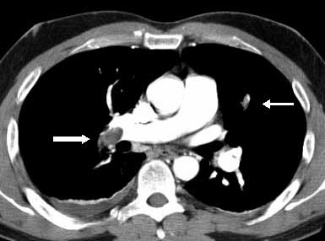
PE Diagnosis:
Chest CT scans

Slide 9
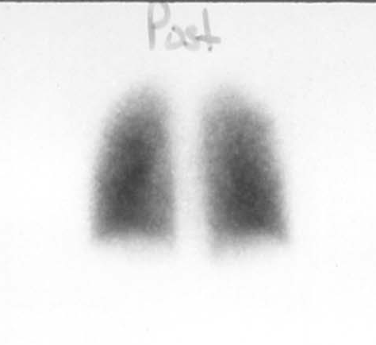
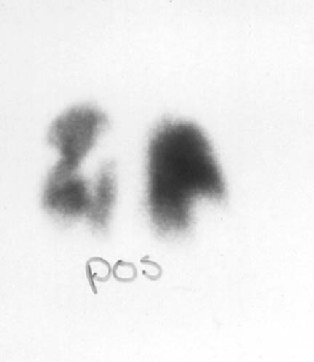
V-Q scan: Perfusion component
Normal
Abnormal
Notes:
Vent: radioactive xenon
Inject: radio iodonated macroaggregated albutim
Pro: less radiation than CT scan, no injected contrast
Con: Must have normal CXR, Most scans are indeterminant

Slide 10
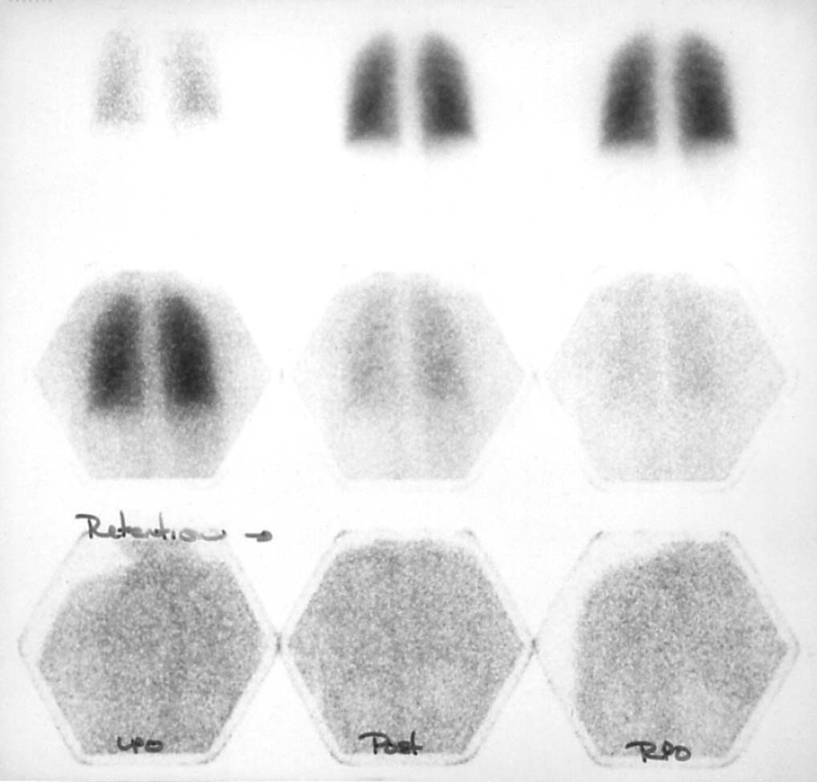
V-Q scan: Ventilation component

Slide 11
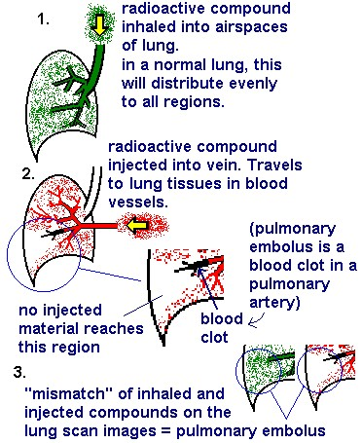
www.bchsys.org

Slide 12
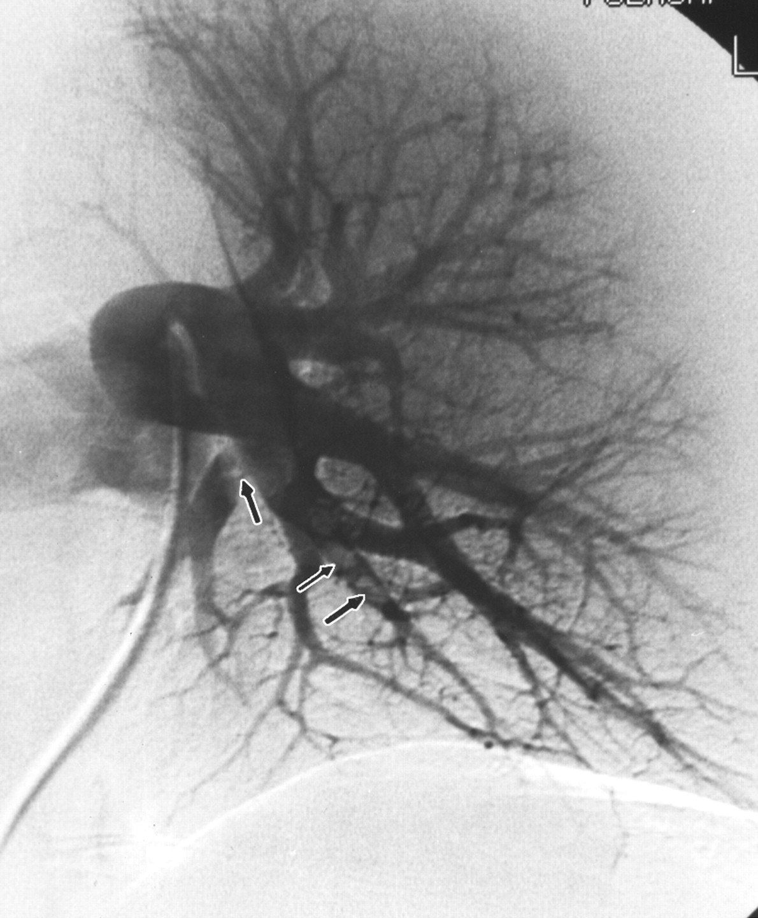
PE Diagnosis:
Pulmonary Angiogram

Slide 13
Principles of radiographic diagnosis of PE
Notes:
Faculty: Use this slide to summarize the tests. We don’t expect students to understand the nuances of when to order each one, just the principles of how they work.

Slide 14
You are quite worried about Ayse, and recommend she go to the Emergency Room as soon as she lands. You offer to accompany her.
During the descent, Ayse has the abrupt onset of severe dyspnea and distress. She is having trouble talking and looks like she might pass out. You check her pulse again. HR = 138 but now hard to feel. You check her carotid pulse, and it is also barely palpable. You ring the call button for the Flight Attendant and clearly state:
“Please get some oxygen immediately. I am a physician in training. She is having a medical emergency. The plane needs to land as soon as possible, and an ambulance needs to be waiting to take Ayse to the hospital..”

Slide 15


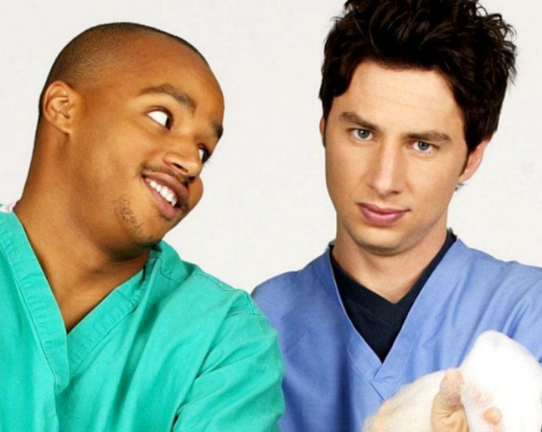
Question 3. What is the role of the physician/health care professional in the non-clinical setting?

Slide 16
The plane is met on the tarmac at Logan and Ayse is brought to the ED by ambulance. A large bore IV is started and she receives a liter of normal saline before reaching the ED. The EMTs obtained the following additional information: She is in a long cast immobilizing her knee. She takes oral contraceptives but no other medications. She does not smoke.
Focused physical exam: She is in marked respiratory distress.
VS: RR 26, BP 92/64, HR 110, SaO2 97% on supplemental oxygen
Chest: few crackles at right base.
Heart: neck veins are elevated at 12 cm, tachycardia, normal S1, S2 is split with a loud P2.
Extremities: right leg is normal, left leg is in long cast, visible part of the left foot appears swollen.

Slide 17
Question 4. Summarize the case. What are the pertinent positives and negatives in her history and on physical exam? What is your next step?

Slide 18
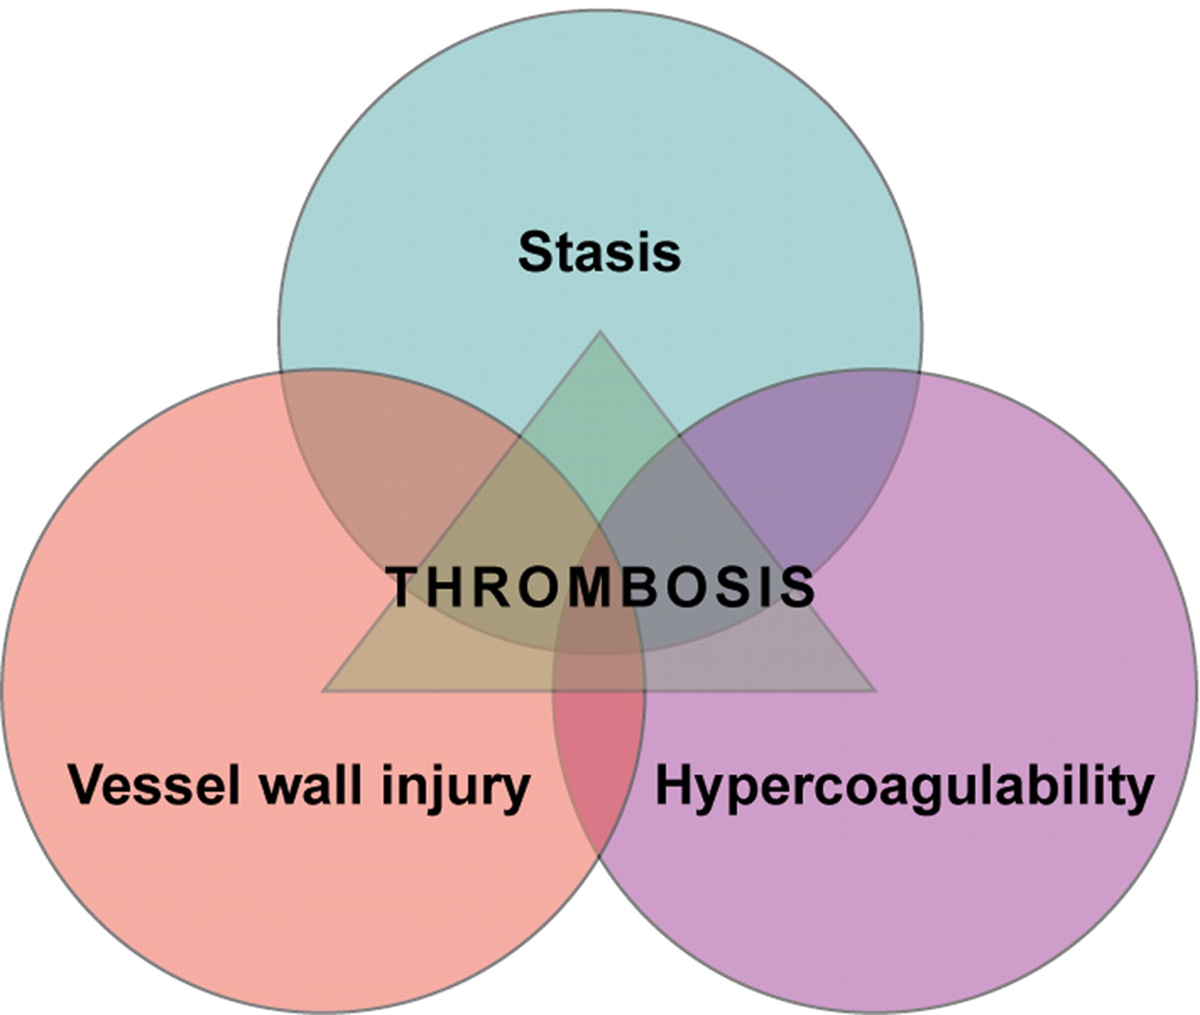
Virchow’s Triad

Slide 19
Intravenous saline is administered, and her blood pressure increases to 104/64, heart rate decreases to 98. She appears much more comfortable. Anticoagulation is started, and further studies are done.

Slide 20
Question 5. A PE protocol chest CT scan confirms multiple large bilateral pulmonary emboli with some evidence of right heart strain. How do the size of pulmonary emboli and a patients underlying cardiopulmonary reserve interact to determine clinical presentation?

Slide 21
Acute PE “syndromes”
Acute
Dyspnea
(or other vague symptom!)
Acute
Cor
pulmonale
Pulmonary
Infarct

Slide 22
Question 6. Which anticoagulant(s) is/are most appropriate at this point? Why? (Please review the mechanism of action of the drugs listed in the objectives on your own—mechanisms are included at the end of the slides.)

Slide 23
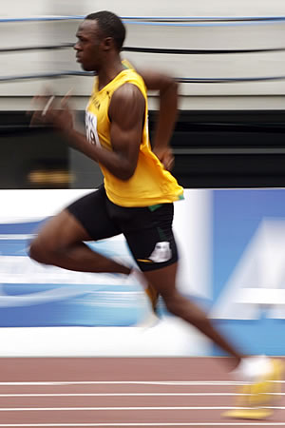
PE: Principles of Treatment
Act fast!
It is the NEXT PE
that can be fatal
Without treatment up to 30% mortality
Usain Bolt –
World Record Holder

Slide 24
Pulmonary embolism- Key points
Lung has dual blood supply
  Pulmonary = low pressure, Systemic = high pressure
Patient presentation depends on interaction between clot burden and patient cardiopulmonary status
Principles of diagnosis:
  D-dimer testing
  Chest CT angio, V/Q scan, Pulmonary angiogram
Prompt anticoagulation
Anticoagulant medications

Slide 25
PTT
PT

Slide 26
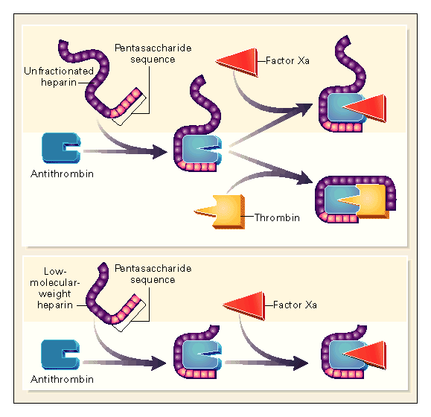

Mechanisms of heparins
Weitz. NEJM. 337:688, 1997
Notes:
Catalysis of Antithrombin-Mediated Inactivation of Thrombin or Factor Xa by Unfractionated Heparin or Low-Molecular-Weight Heparins. The interaction of unfractionated heparin and low-molecular-weight heparins with antithrombin is mediated by the pentasaccharide sequence of the drugs. Binding of either to antithrombin causes a conformational change at its reactive center that accelerates its interaction with factor Xa. Consequently, both unfractionated heparin and low-molecular-weight heparins catalyze the inactivation of factor Xa by antithrombin. In contrast to factor Xa inhibition, catalysis of antithrombin-mediated inactivation of thrombin requires the formation of a ternary heparin-antithrombin-thrombin complex. This complex can be formed only by chains at least 18 saccharide units long. This explains why low-molecular-weight heparins have less inhibitory activity against thrombin than unfractionated heparin.

Slide 27
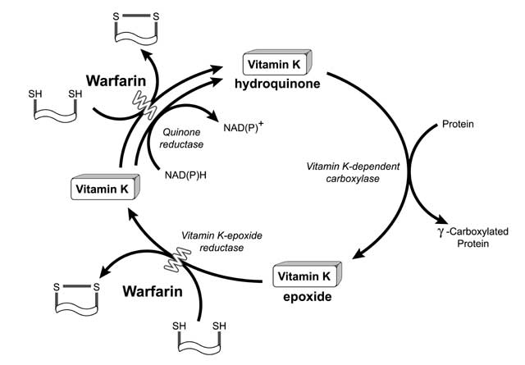
Mechanism of Warfarin
Notes:
Vit K is a necessary cofactor in the carboxylation of glutmate residues on Vit K depend proteins ( 2, 7, 9 and 10)—during this reaction Vit K is oxidized to an inactive form. The regeneration of reduced Vit K is essential for sustained synthesis of functional proteins. This regeneration is blocked by warfarin.
Doesn’t work right away—have to deplete available clotting factors first

Slide 28
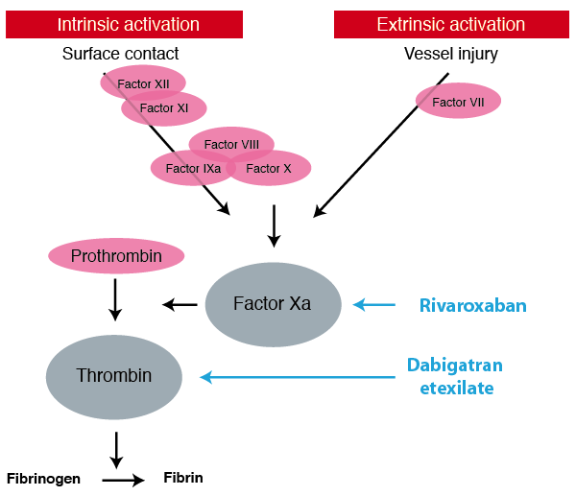
Oral Xa inhibitors
Eg. Rivaroxaban
Apixaban
Direct thrombin inhibitors
Eg. Dabigatran, Argatroban
Fibrin Clot

Slide 29
Thrombolytic Therapy
Fibrin
Plasminogen
Tissue plasminogen
activator “TPA”
Plasmin
Fibrin Clot
Fibrin Degration Products
(d-dimers and others)
Fibrin
Notes:
The anticoagulalants block formation of the fibrin clot.

